Slide 1
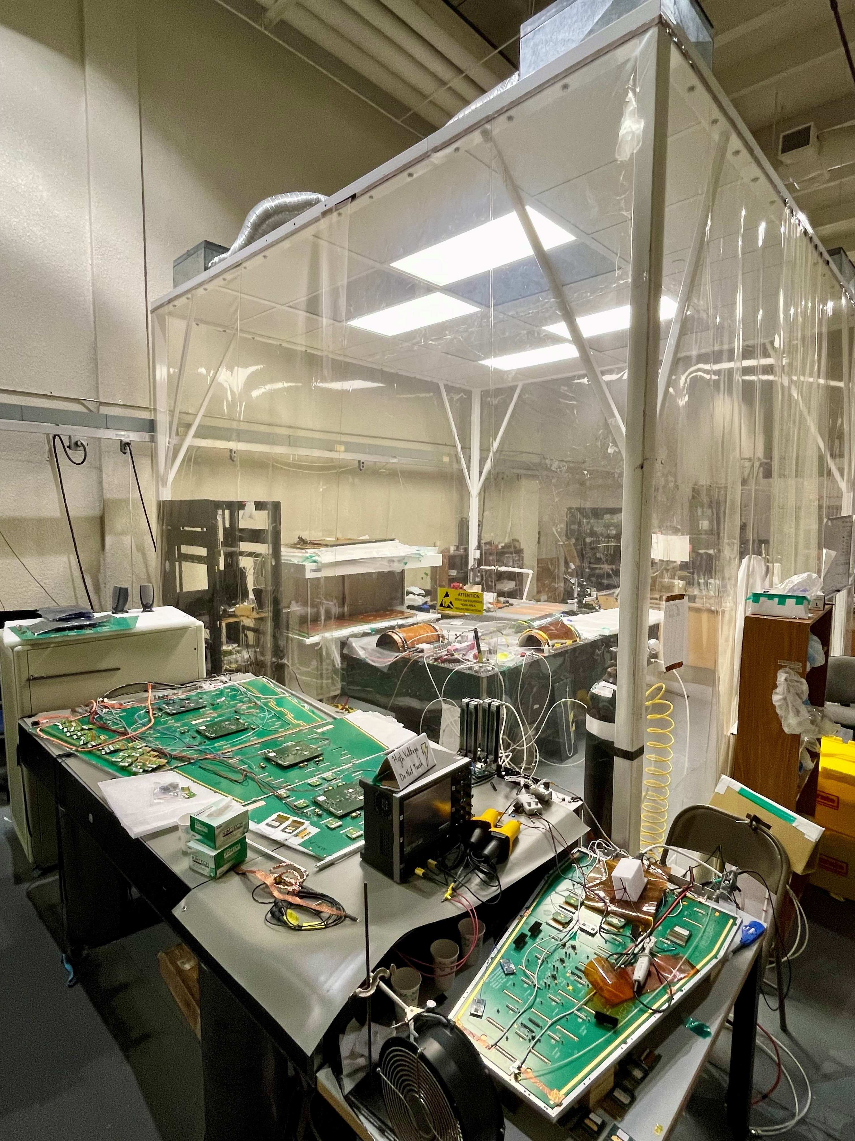
Expression of Interest for US FCC studies
Presented by: Marcus Hohlmann
On behalf of: Florida Institute of Technology
Second Annual U.S. Future Circular Collider (FCC) Workshop 2024
25 Mar - 27 Mar, 2024; hosted by MIT
PIs: M. Hohlmann, Souvik Das
Group: 1 postdoc, 7 Ph.D. students, no engineers/technical
Expertise, facilities, ongoing and past experience, efforts on physics, theory, accelerator or detector R&D:
Hohlmann:
First US group on GEM upgrade of CMS muon endcap (module prod., electronics integration)
Ten years of R&D on gaseous tracking detectors for ePIC detector at Electron-Ion Collider
Large gas detector lab (cleanroom, X-ray irradiation box, DAQ systems)
Das:
Seven years R&D making and characterizing diamond-doped high-thermal-conductivity carbon
fiber and radiation-hard thermal interface materials for CMS Inner Tracker structural cooling
Expertise with Si-detector assembly, fine-pitch wire bonding, testing
R&D on Xilinx firmware development for CMS Phase 2 Track Trigger
Currently equipping a Si-detector cleanroom at FIT
Current efforts at CERN and other major experiments: CMS, DRD1 (previously RD51), ePIC@BNL
Notes:
Please take note of the following instructions:
The maximum number of slides allowed is two. Please provide the names of all Principal Investigators (PIs) interested in joining the FCC project. Also, please indicate the expected number of postdocs, students, engineers, and technical staff joining the project.
Describe your existing facilities, expertise, and efforts briefly. It is sufficient to use keywords. No details are necessary.
List current membership in major experimental collaborations.

Slide 2
Estimated short-term (FY24-FY25) involvement in FCC activities:
(Scientific: Base program supported people, Technical: Other funding source)
Activity (Detector or Accelerator R&D, Software, Physics studies only until end of FY25) | Category | Scientific (FTE) | Technical (FTE)
Cylindrical MPGDs with fast timing operated with eco-friendly gases for tracking applications (MH) | DRD1 | 0.1
Development of MPGD production facilities in US (MH with JLAB) | DRD1 | 0.05
Coordination of Muon Detector & Gaseous Detector (MDGD) efforts in US (MH) | DRD1 | 0.1
Development of low mass support and cooling structures for Si trackers (SD) | DRD3 | 0.1
AI/ML implementation in ASICs (SD) | DRD7 | 0.03
Development of AI/ML, neuromorphic algorithms for Trigger & DAQ Systems (SD) | Other | 0.02
Category = Either the DRD/RDC group(s) or say Other.
Category = Either the DRD/RDC group(s) or say Oth
Are you interested in developing a US led detector concept for FCC-ee? Y (MH for MDGD)
Group point of contact: Marcus Hohlmann, hohlmann@fit.edu

