Slide 1

Design, Assembly, and Testing of a Small 3D-printed Thick-GEM
Jerry Lamar Collins II

Slide 2
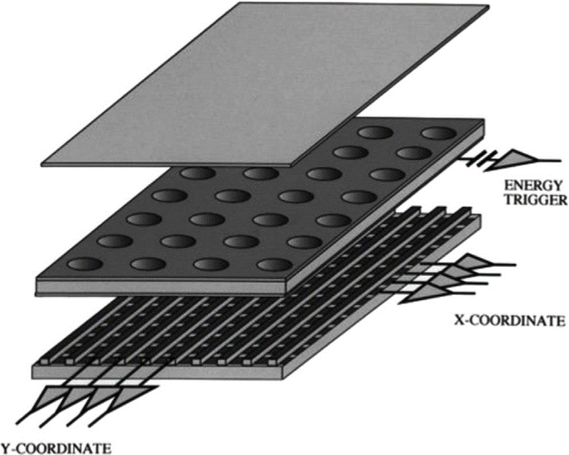
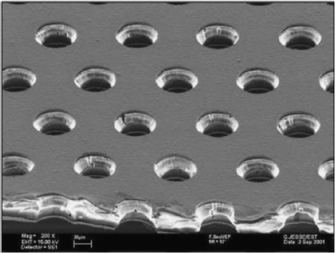
GEM Detectors
Gas Electron Multiplier
Gaseous detectors
Drift cathode, GEM foils, Readout anode
Exploits ionization throughout gas volume

Slide 3
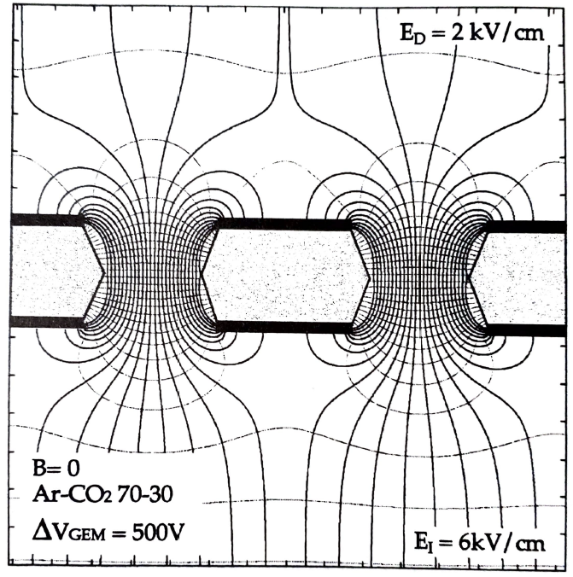
GEM Holes
High potential difference across foil sides, high electric field
Freed electrons accelerated through GEM holes
High energy collisions cause further ionization
Electron avalanche, signal amplification

Slide 4
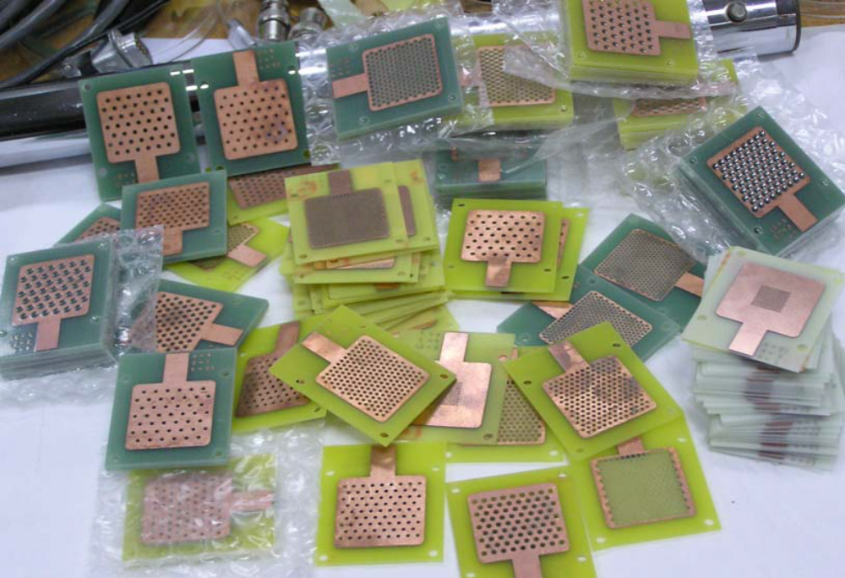
Thick GEMs
Thicker version of GEMs
Typically made of sturdier, more robust, PCB material
Usually formed through PCB techniques, hole drilling
Can be made cheaply
Larger holes
Comparable gain, moderate localization resolution
High rate capabilities, fast signal production
R. Chechik, et al. Progress in Thick GEM-like (THGEM)-based Detectors. SNIC @ SLAC April 2006

Slide 5
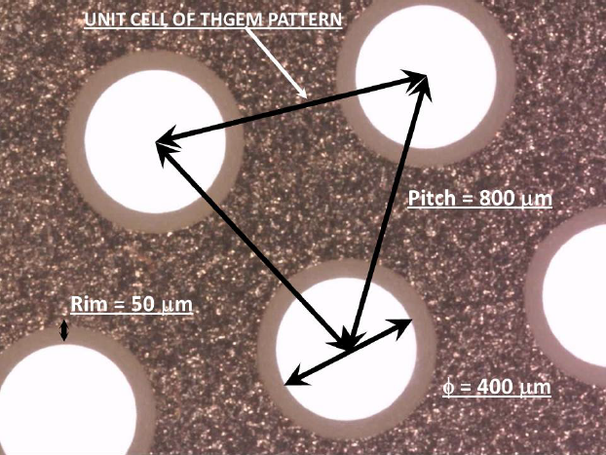
THGEM Rims
Clearance rims instead of double-conical holes
Can have effects on the gain, as well as long-term effects

Slide 6
Question
Can a 3D-printed Thick GEM serve as a functioning GEM in a detector?
Effects of Rims on gain
Long-term evolution of gain

Slide 7
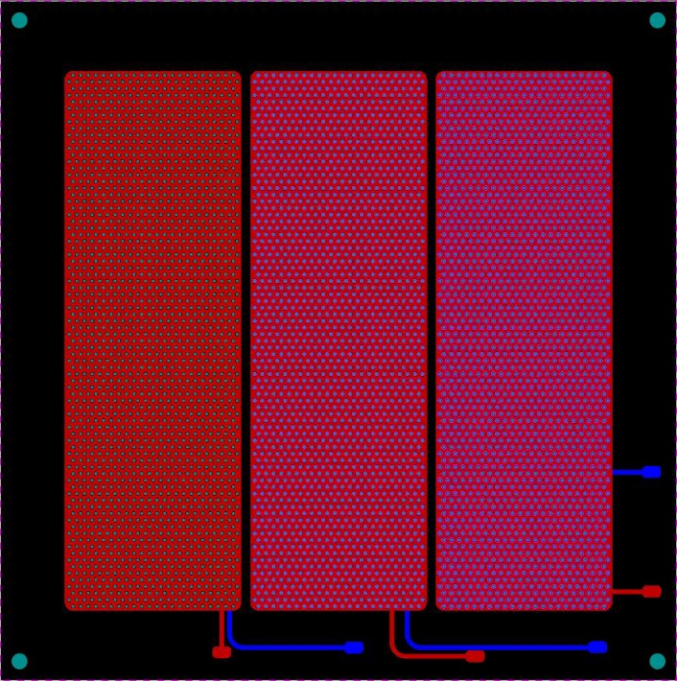
Design
Design produced, having traces leading to pads for mounting HV
10 cm × 10 cm divided into 3 10 cm × 3.3 cm sectors
Powered independently within this “10×10 Detector”
Three THGEMs on one board

Slide 8
Board Design Details
All holes 0.7 mm
Pitch 1.4 mm
Thickness 0.7 mm
Rims (left sector to right): 0 mm, 0.1 mm, 0.18 mm

Slide 9
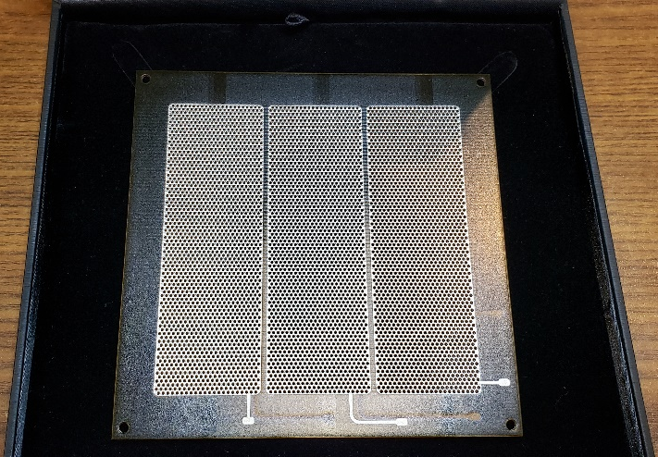
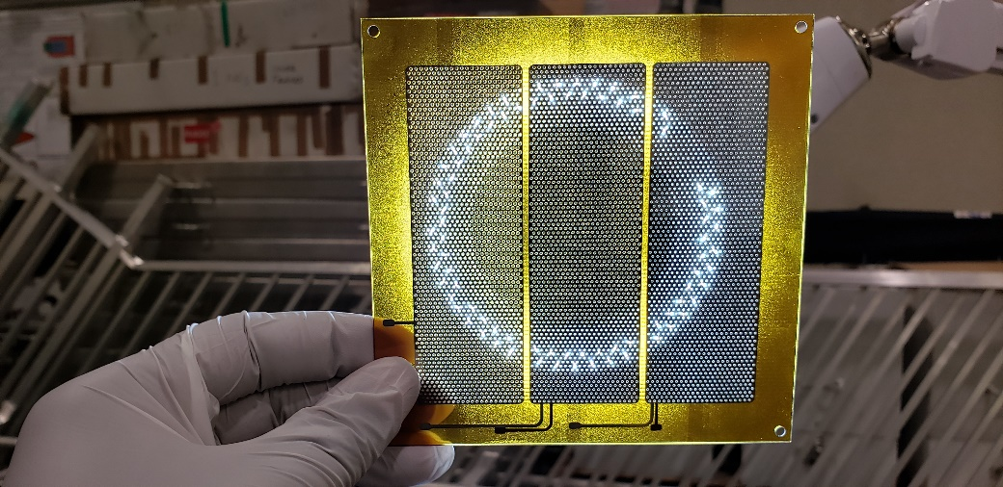
Successful THGEM Arrival

Slide 10
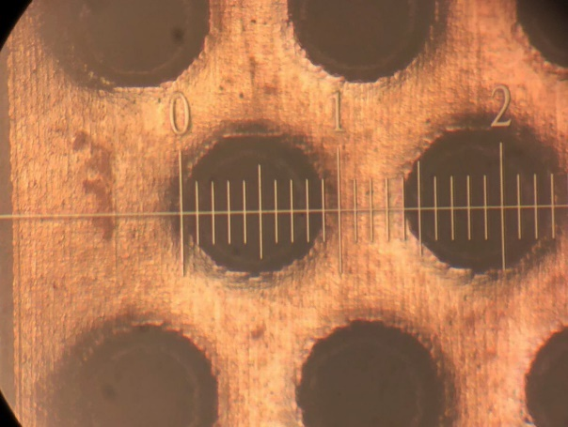
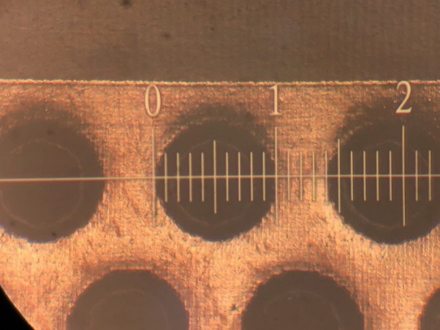
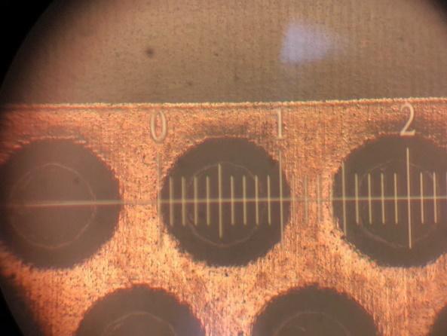
Hole Microscopy Investigation
No solder mask, holes look much more uniform
Free of troublesome printing artifacts
Holes for all sectors were 0.7 mm diameter
Sector designed for no rim actually 0.1 mm rim
Sector designed for 0.1 mm rim actually 0.15 mm rim
Sector designed for 0.18 mm rim actually 0.2 mm rim
“No rim”
“0.1 mm rim”
“0.18 mm rim”

Slide 11
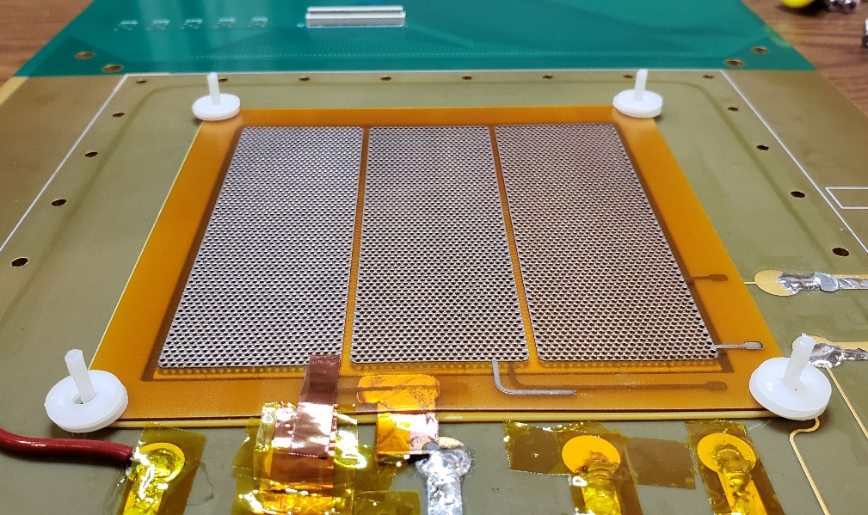
Assembly
THGEM placed atop spacer
  gives 1 mm induction gap
Three 1-mm washers in each corner
  Forms 3 mm drift gap

Slide 12
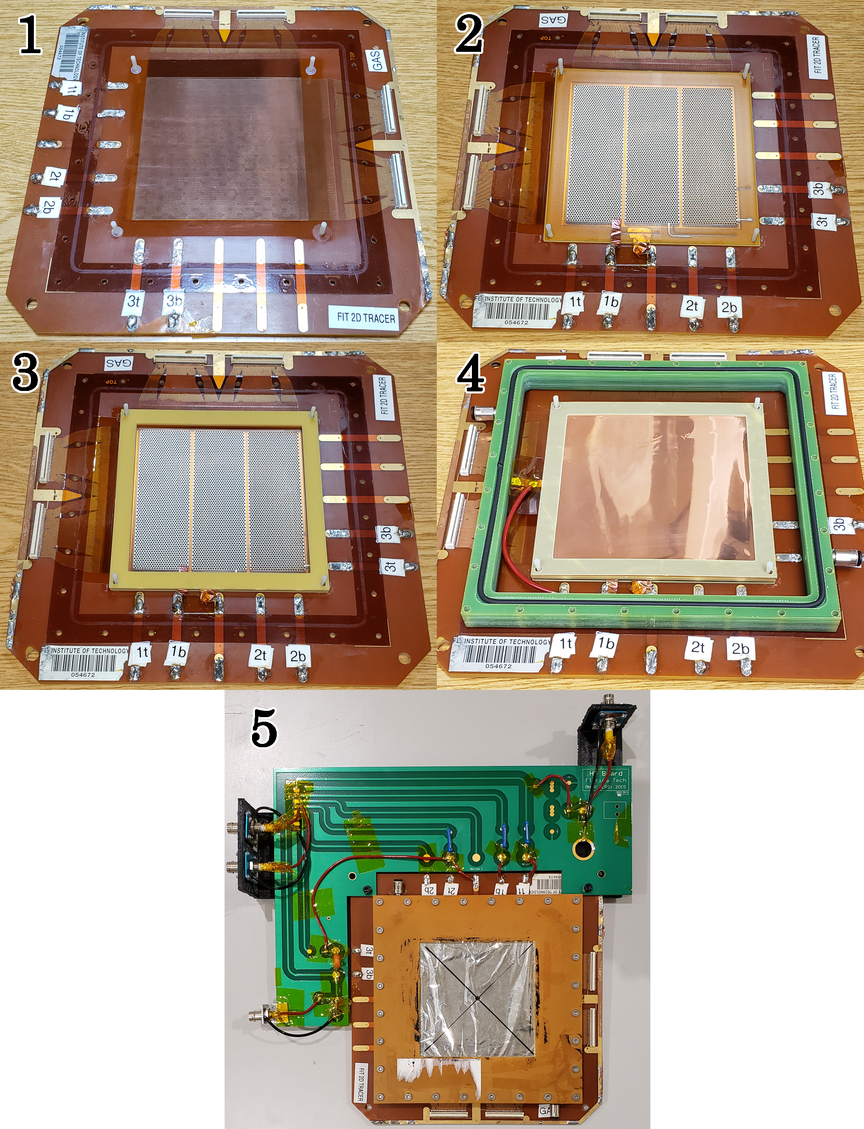
Assembly

Slide 13
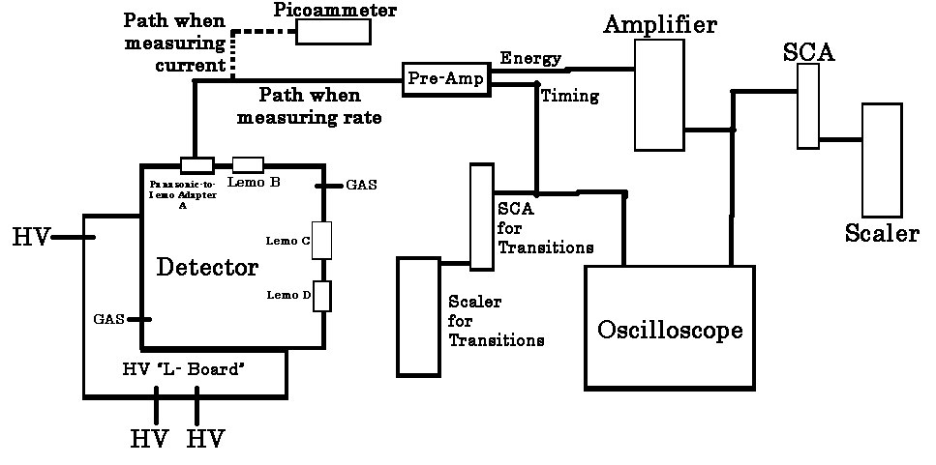
Readout Electronics Chain
Readout electronics chain used during testing. Note: Energy and Timing outputs from the Pre-amp are just labels; the signal out of both is identical. SCA: Single Channel Analyzer.

Slide 14
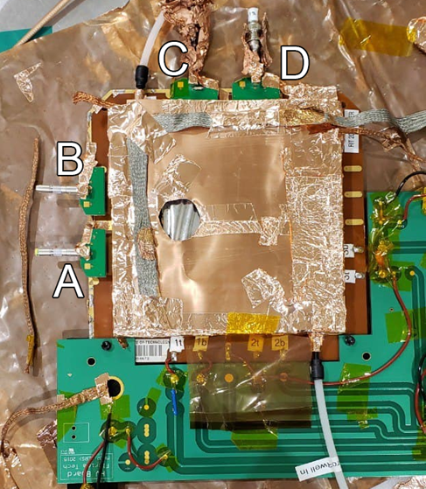
Assembly
Readout has two sets of 128 straight strips each in X and Y directions
4 total Panasonic connectors
Signal charge induced by collected electrons → Panasonic connector → Panasonic-to-lemo adapter → pre-amp
  Strips ganged together to form one signal per adapter
Adapters labeled A, B, C, D
C used for small rim sector, B used for medium rim, D used for large rim, unless otherwise indicated

Slide 15
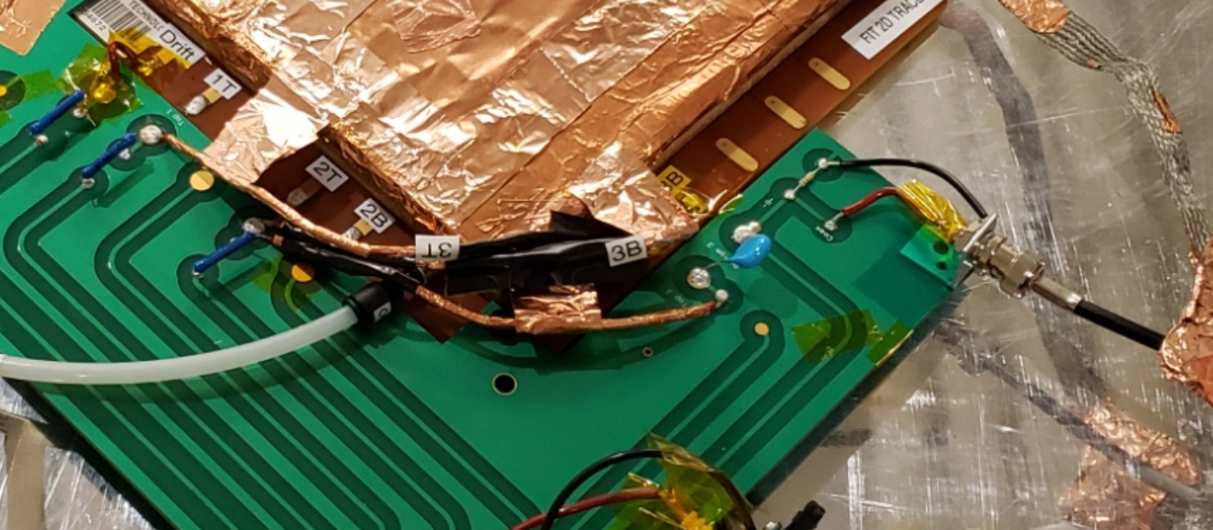
Reading off THGEM Bottom
It is also possible to read off of THGEM Bottom
Special connection from end of testing shown here

Slide 16
Testing
Gas leak check
Test for shorts on the board
Gas gain for each THGEM sector
  Long-term behavior as well
Test for any malfunctions

Slide 17
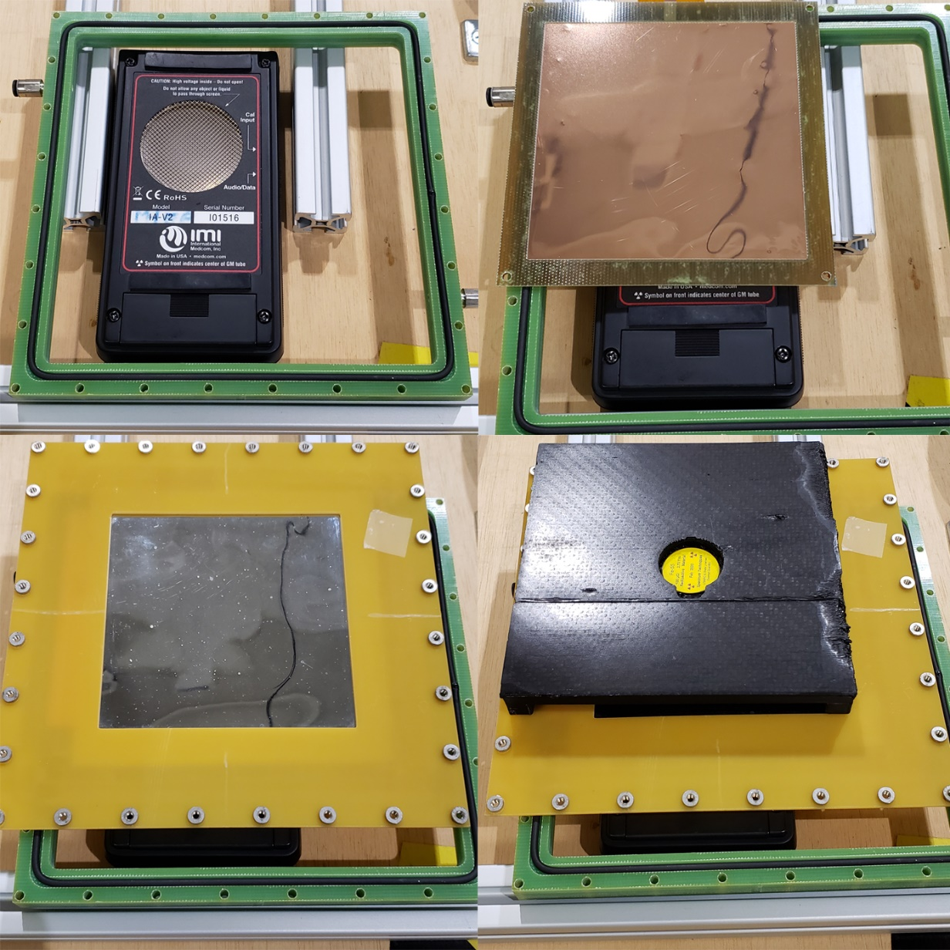
X-ray Penetration of Foils
Test designed to be similar conditions to gain testing
Fe-55
  Without Foils
    Without Source: 0.52 ± 0.10 Hz
    With Source: 1673.33 ± 19.23 Hz
  With Foils
    Without Source: 0.78 ± 0.12 Hz
    With Source: 592.00 ± 8.07 Hz
  35.4% X-ray penetration
Cd-109
  Without Foils
    With Source: 152.30 ± 2.86 Hz
  With Foils
    With Source: 122.02 ± 2.44 Hz
  80.1% X-ray penetration

Slide 18
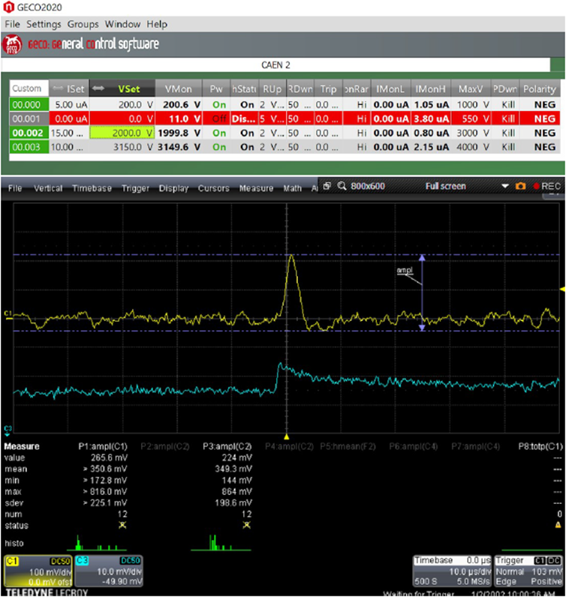
Test of Small (0.1mm) Rim Sector
Initial observations made using scope to take counts
Fe-55 used
HV settings of electrodes
C1 pre-amp + amp, C3 pre-amp
Induction field 2 kV/cm
Bias voltage 1800V ⇒ THGEM hole field 25.7 kV/cm
Drift field 3.83 kV/cm
Rate low
Moments of sparking, overvoltage on bottom, wild scope behavior

Slide 19
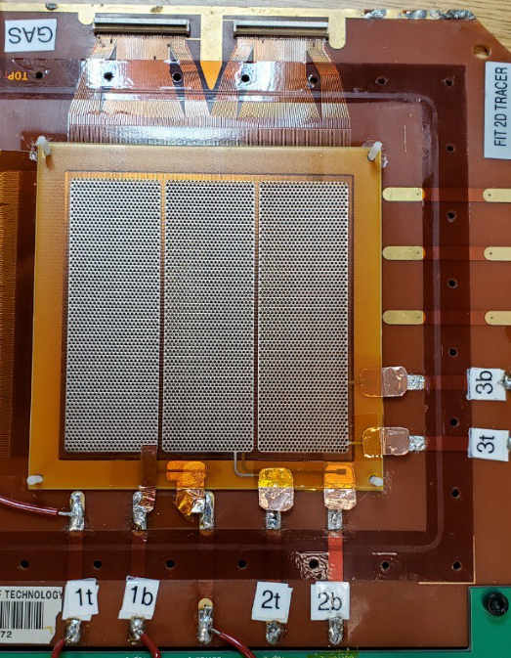
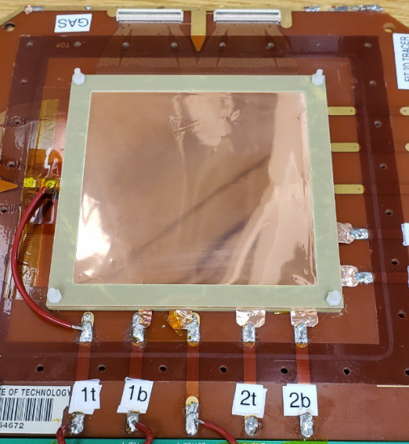
Discharge Concerns and Next Steps
Bias voltage limit “wall” of around 1900V
Suspect hole fields not high enough
Want to avoid increasing bias due to discharge
Switched to next largest sector
Copper tape tabs for each sector

Slide 20
Test of 0.15 mm Rim (Middle) Sector
Drift and Induction fields 3 kV/cm
At 1800V bias there was no significant difference on THGEM Bottom or Lemo C
No significant difference at 1900V
2000V on Lemo C we see the first significant difference
  Source off: 25.77 ± 1.78 Hz
  Am-241 on: 60.40 ± 3.30 Hz
  134.38% increase
2100V
  Source off: 34.27 ± 2.17 Hz
  Am-241 on: 92.20 ± 4.50 Hz
  169.04% increase
Few instances of discharge occurred

Slide 21
Test of 0.15 mm Rim (Middle) Sector
For Lemo D, again at 1800V bias there was no significant difference
No significant difference at 1900V (though more difference than for Lemo C)
2000V again marks significant difference
  Source off: 4.00 ± 0.60 Hz
  Am-241 on: 34.53 ± 2.18 Hz
  763.25% increase
No bias wall preventing, continued
2100V
  Source off: 6.43 ± 0.73 Hz
  Am-241 on: 87.73 ± 4.29 Hz
  1264.39% increase
2200V
  Source off: 6.10 ± 0.70 Hz
  Am-241 on: 74.60 ± 3.80 Hz
  1122.95% increase
  Occasional discharges
Frequent discharge under Am-241 or Fe-55 at 2300V

Slide 22
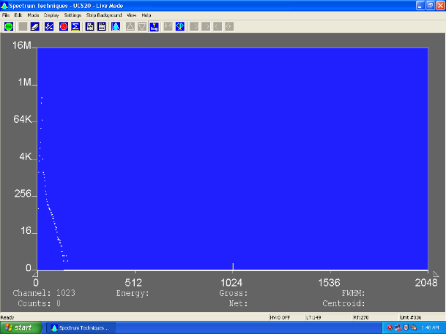
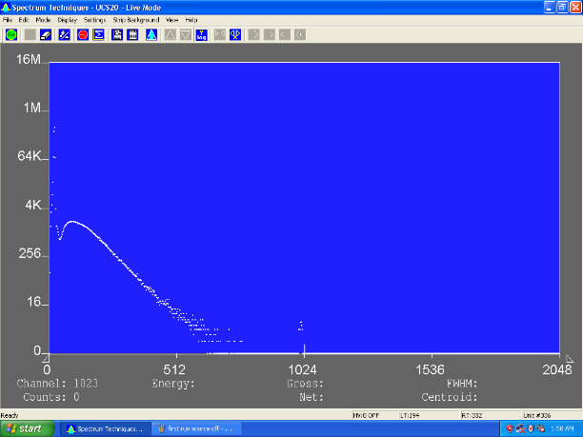
Pulse Height Measurements
Initial pulse-height measurements taken using a Multi-Channel Analyzer source-off (left) and source-on (right)
Visual evidence of the detector functioning!

Slide 23
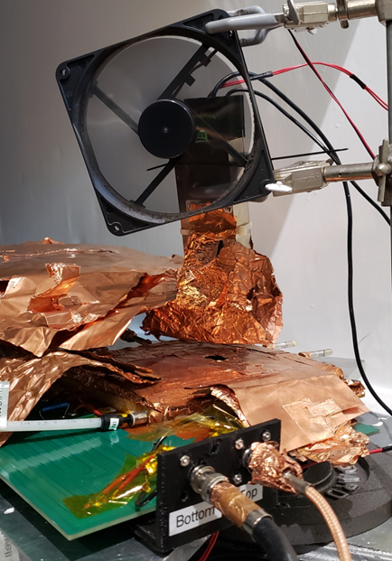
Gas Gain Tests
Goal: Gather gain curves for each THGEM
Fe-55 and Amptek Mini-X X-ray gun used as X-ray source
Detector set up inside lead-lined box
X-ray gun suspended ~1 cm over detector
Operated via laptop outside of box
Interlock systems shuts off X-ray gun if door opened while on
Arrow indicates the X-ray gun. The purpose of the fan is to keep the X-ray gun cool and maintain operating temperature

Slide 24
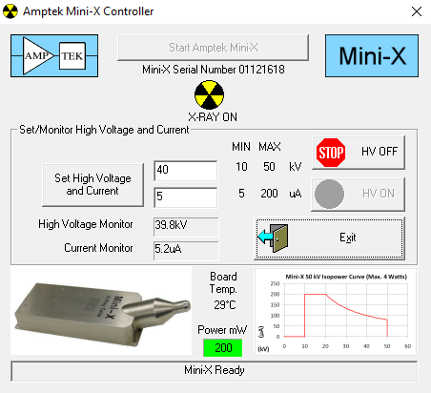
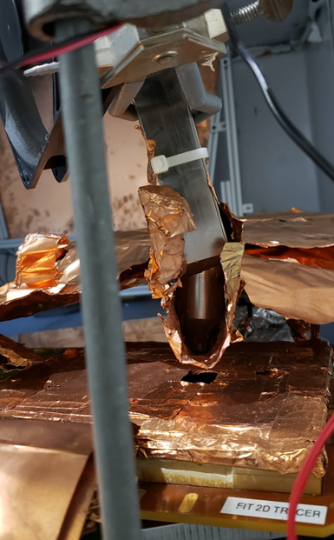
X-ray Gun

Slide 25

Middle Sector – 1st Gain Test
Detector kept off for >24 hours
X-ray off and on current and rate measurements
Drift and induction fields constant, increasing THGEM Bias Voltage
X-ray set to 40 kV 5 μA

Slide 26
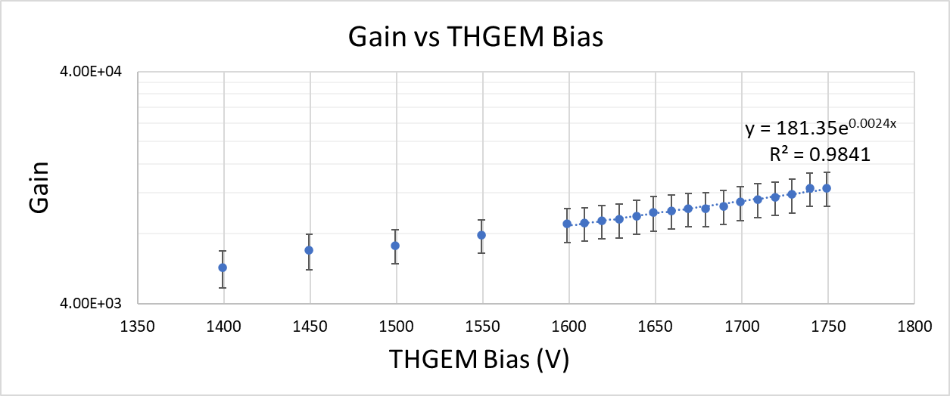
Middle Sector – 1st Gain Test
Incident Rate of 1879.41 ± 289.23 based on Geiger counter values used. Max of 1750V to avoid discharges typical beyond 1800V.

Slide 27
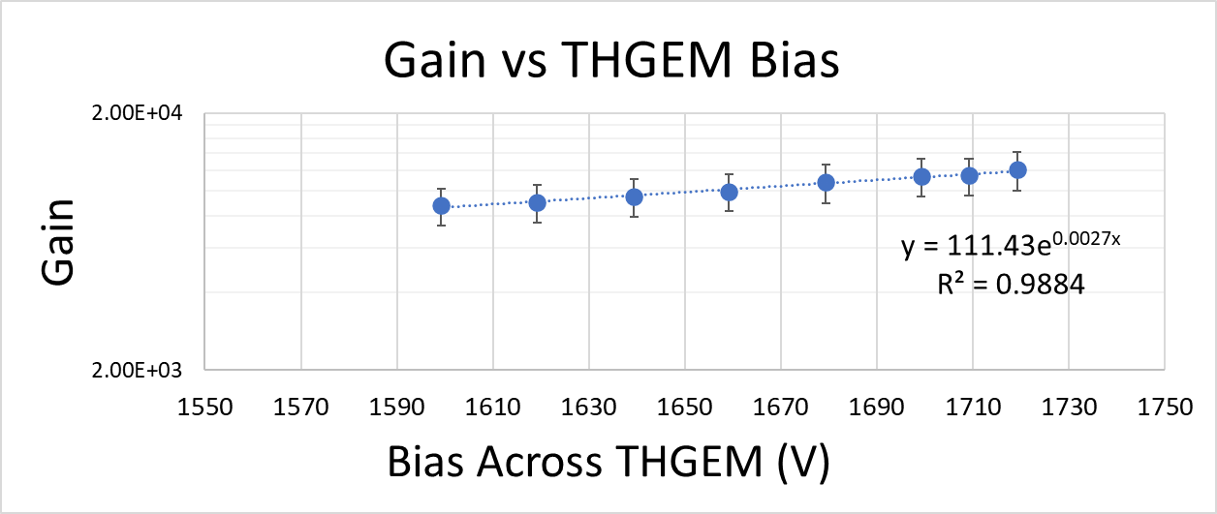
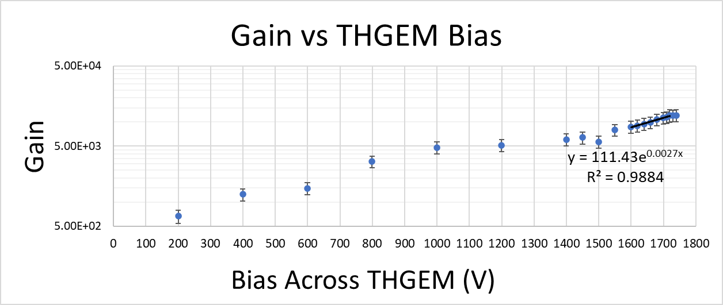
Middle Sector – 2nd Gain Test

Slide 28
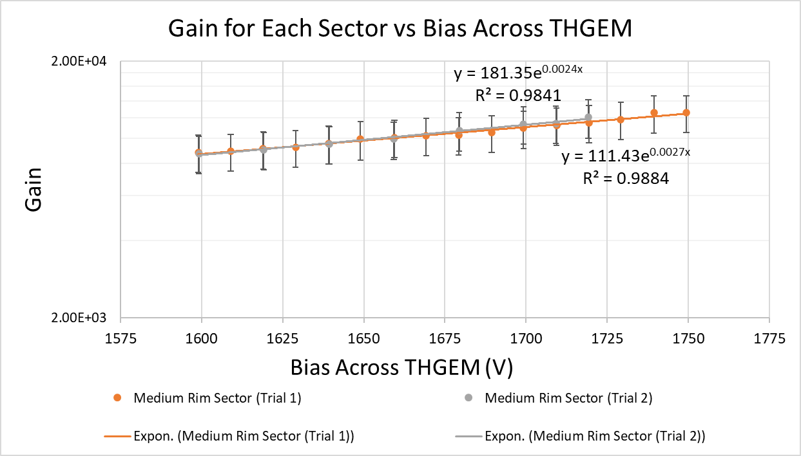
Middle Sector – 2nd Gain Test

Slide 29
Next Gain Tests
Switching to Fe-55 out of abundance of caution
Large Rim Sector up next

Slide 30
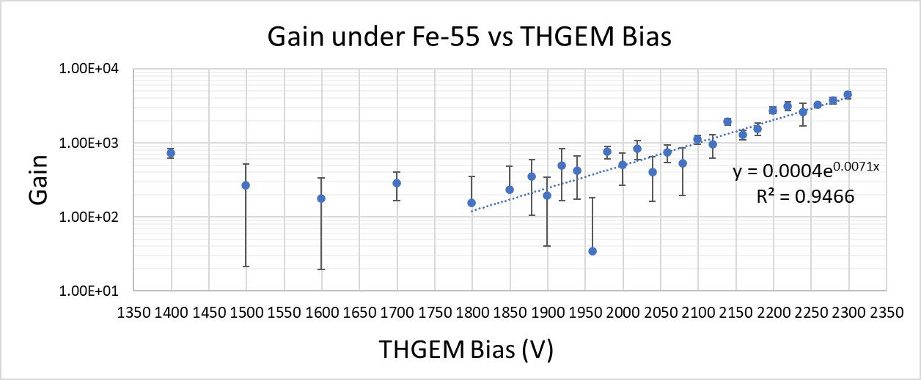
Large Rim Sector – Gain Test
Fe-55
Incident Rate: 591.22 ± 8.20 Hz

Slide 31
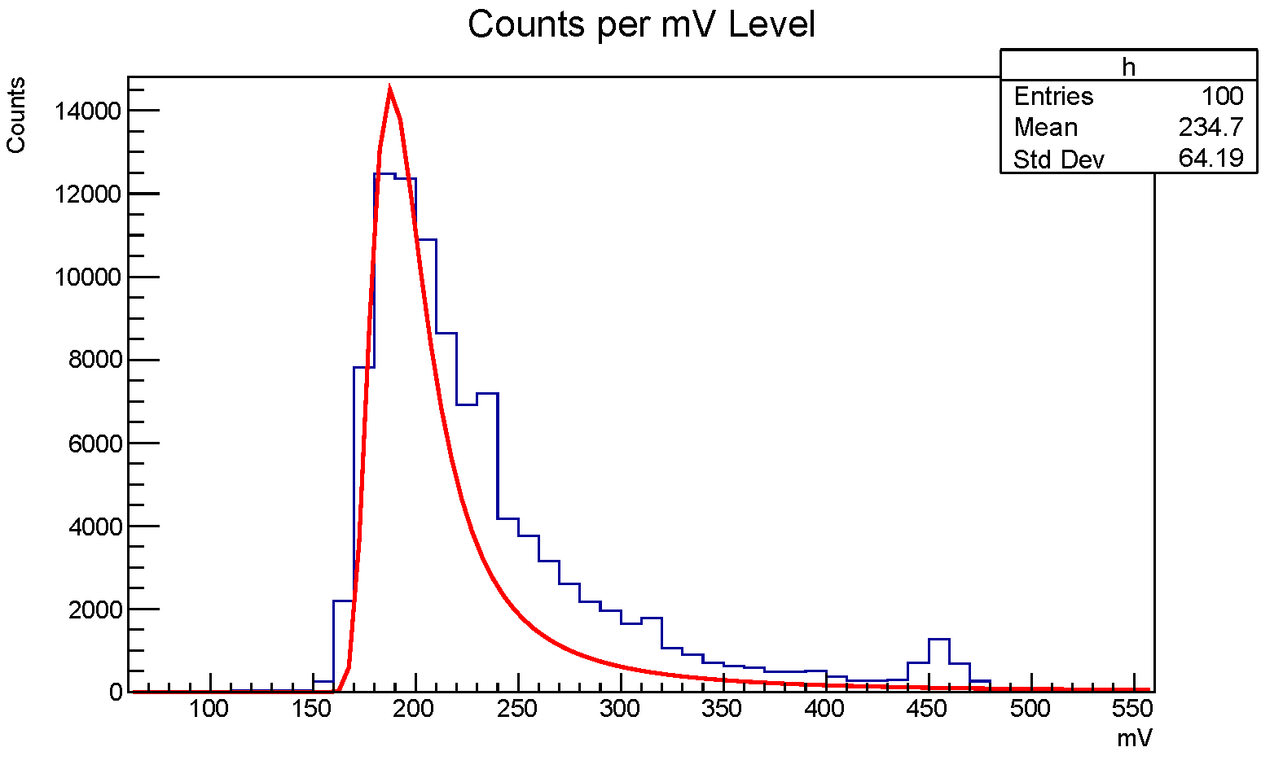
Large Rim Sector – Gain Test
Pulse height distribution under Fe-55
THGEM Bias 2200V
Landau fit MPV 189.83 ± 0.10 mV

Slide 32
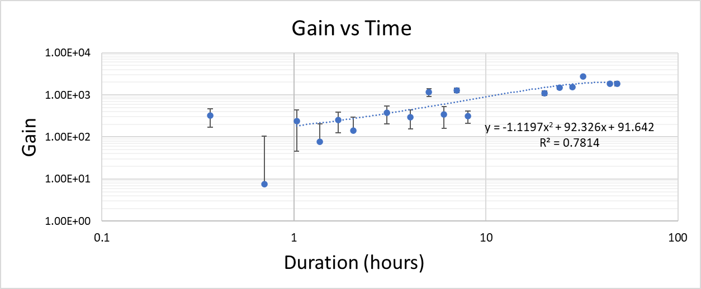
Large Rim Sector – Gain Test 48-hour
Every 20 mins for first 2 hours, then once per hour for the remainder of 8 hours
Came back and measured next day and then every 4 hours for 12 hours
Came back next day and took a measurement, then one more after 4 hours to complete 48 hours
Held at 2120V under Fe-55 constantly

Slide 33
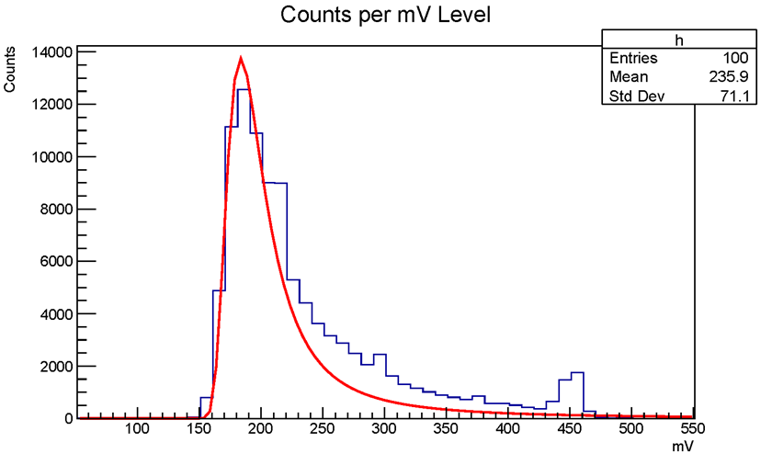
Large Rim Sector – Gain Test 48-hour
Pulse height distribution under Fe-55 toward end of 48-hour study
THGEM Bias 2120V
Landau fit MPV 185.54 ± 0.09 mV
Both have primary peak ~190 mV

Slide 34
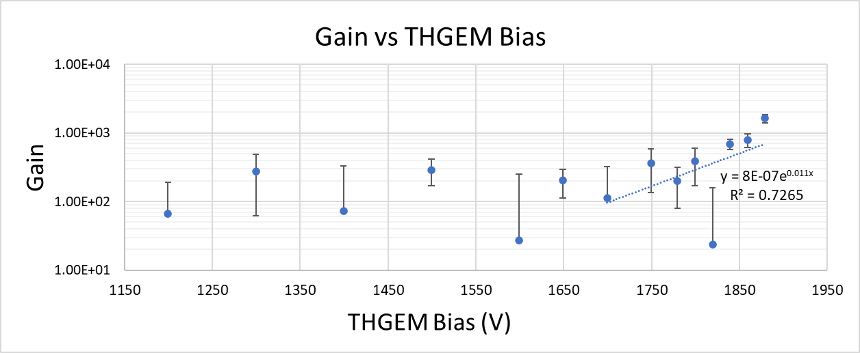
Small Rim Sector – Gain Test

Slide 35
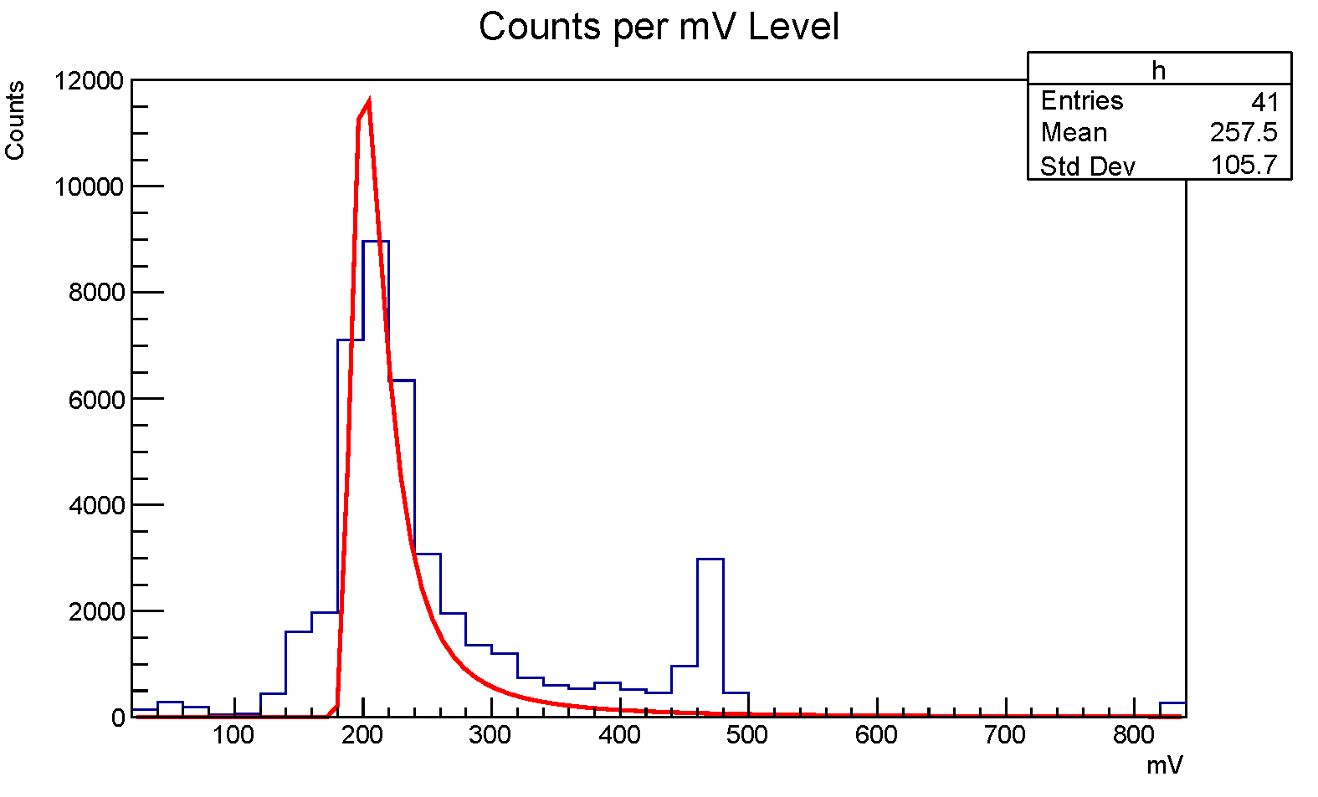
Small Rim Sector – Gain Test
Pulse height distribution under Fe-55
THGEM Bias 1840V
Landau fit MPV 202.41 ± 0.11 mV

Slide 36
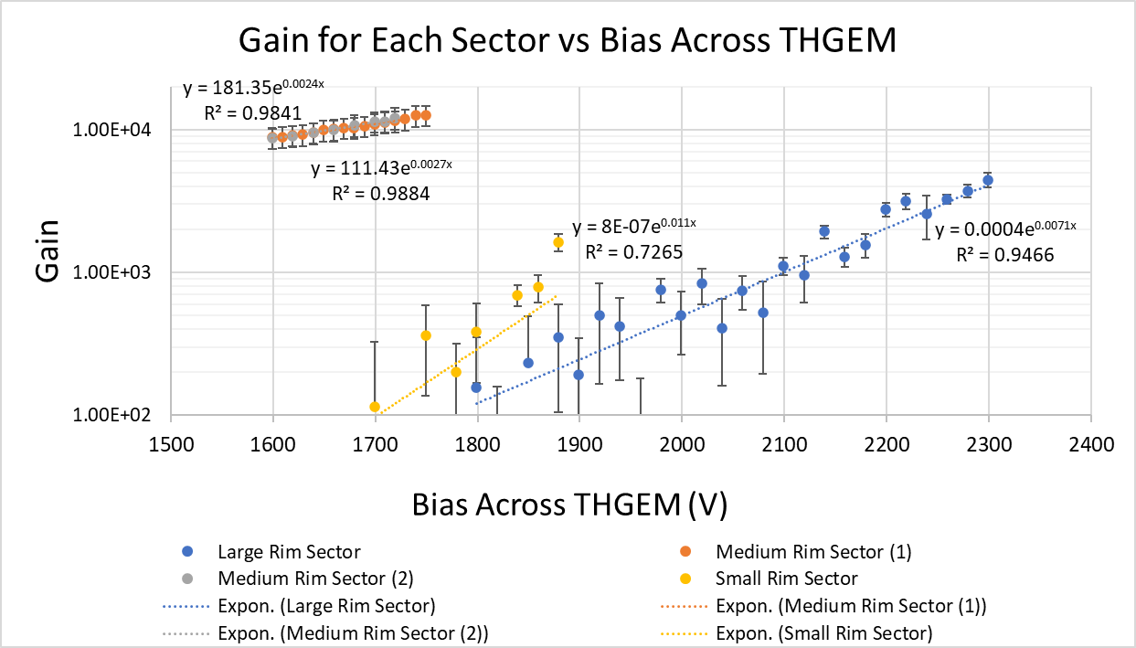
Gain vs THGEM Bias Voltage – All Sectors

Slide 37
Long-term Tests
THGEM under Fe-55 irradiation for 5-48 hours
Observe HV stability, long-term evolution of count rate and gain
Behavior of positive-to-negative “transitions” (large pulses with negative components). A removal of the rate of these transitions from the count rate was known as the “corrected” value
Second Timing SCA added to count transitions

Slide 38
First Long-term Test
Middle Sector, Lemo D
Drift and induction fields 3 kV/cm
THGEM Bias 2000V
Fe-55 X-ray source

Slide 39
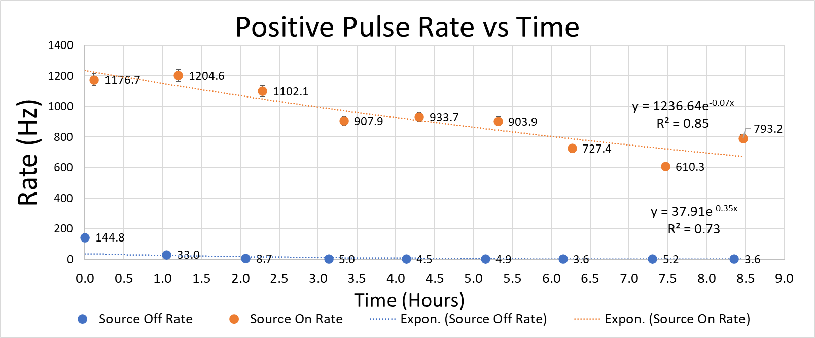
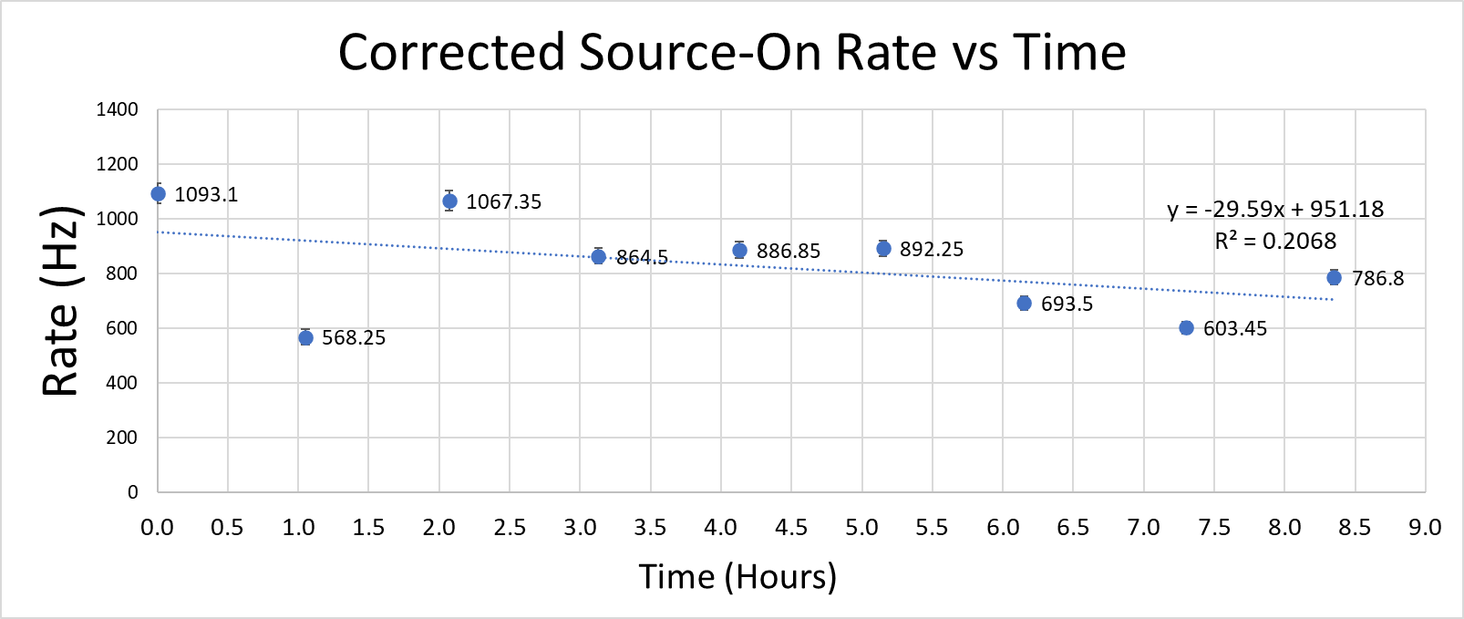
First Long-term Test
Note: Fe-55 removed in between data-taking

Slide 40
Second Long-term Test
Kept Fe-55 on constantly to observe behavior with charging up of insulating material
HV monitor information maintained
Leakage current from HV module
  Constant unless discharge or similar phenomenon

Slide 41
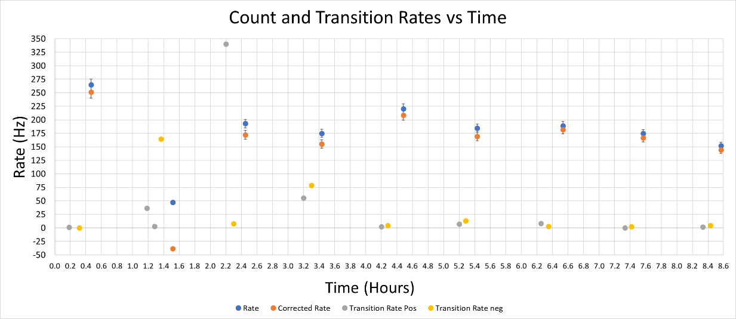
Second Long-term Test

Slide 42
Third Long-term Test
Over ~48 hours
Detector constantly 3 kV/cm drift and induction fields, 2000V THGEM bias, Fe-55
Every 20 mins for 2 hours, every hour for remainder of 8 hours, next day every 4 hours, then final 2 points the day after

Slide 43
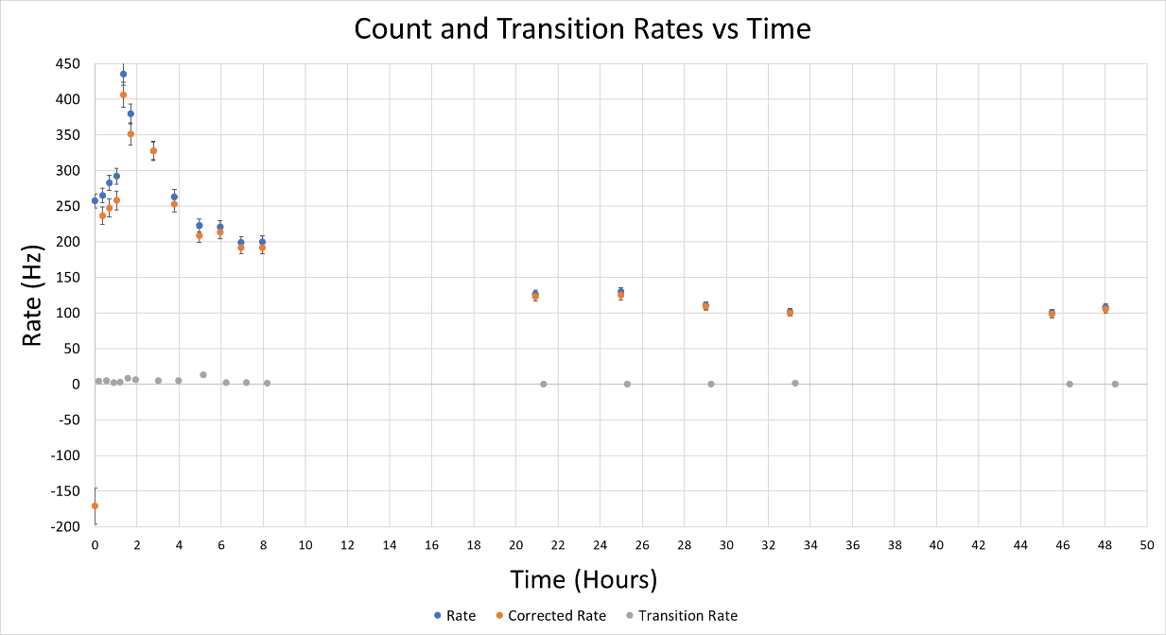
Third Long-term Test
Notice the difference between Rate and Corrected shrinks over time, meaning negative pulse (and overshoot) rate drops over time

Slide 44
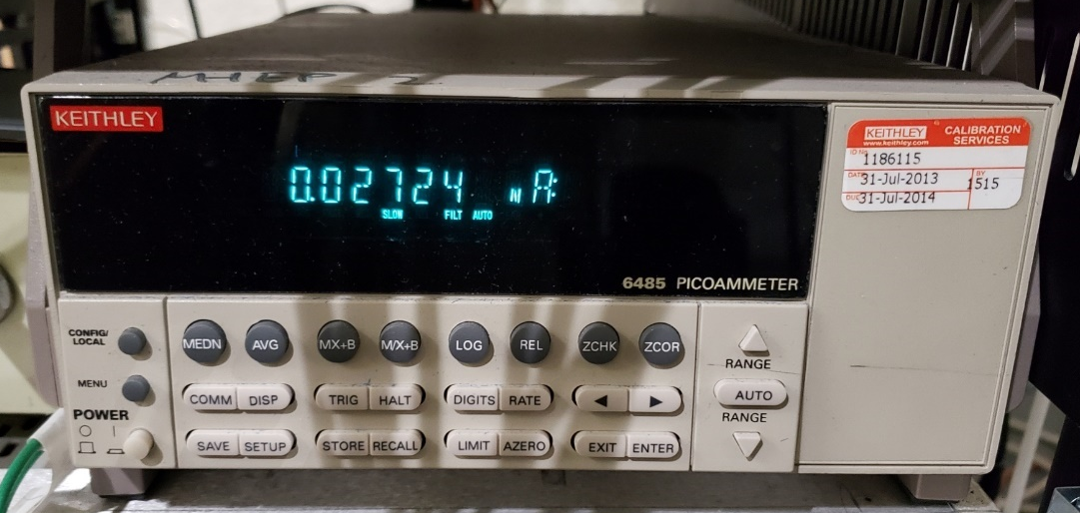
Fourth Long-term Test
Want to investigate and confirm the initial behavior as seen in previous plot
Repeated shorter version of trial
Signal current monitored throughout, source-off reference at end
Allow for an approximation of gain over time
Incident Rate 591.22 ± 8.20 Hz used
Keithley Picoammeter used for signal current measurements

Slide 45
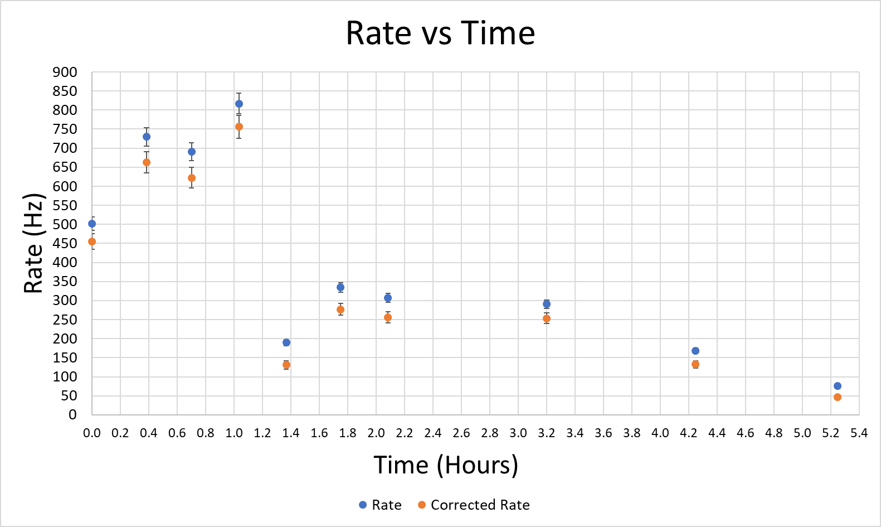
Fourth Long-term Test

Slide 46
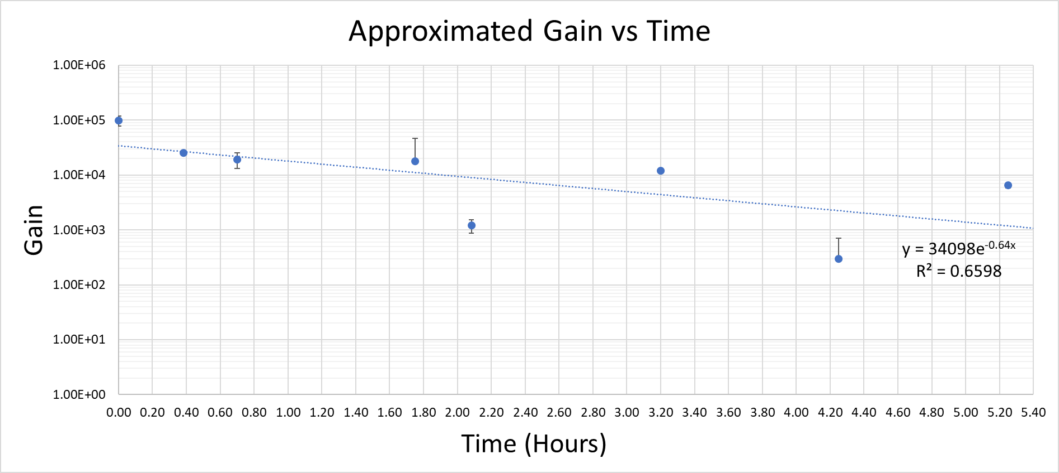
Fourth Long-term Test

Slide 47
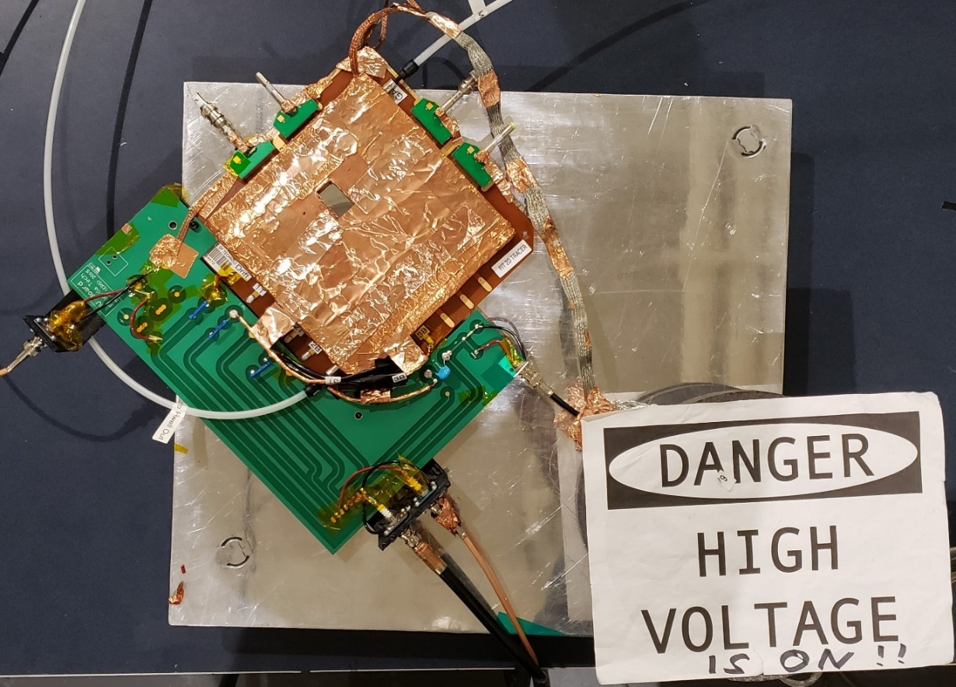
HV Functionality
Each sector tested under pure CO₂
Observe functionality without amplification
Read off THGEM Bottom
  Allows to gather data from full sensitive area

Slide 48
HV Functionality – Small Rim Sector
Constant 2.6 kV/cm induction field, 1.8 kV/cm drift field
Taken through several bias voltage levels
Count rate of 0 Hz was found regardless of voltage
  Reasonable as no electron avalanche

Slide 49
HV – Functionality Medium and Large Rim Sectors
Medium and Large rim sectors did not function as smoothly
Medium sector at 1000V and lower than standard drift field showed instability on Bottom and scope, overvoltage
Large sector better than medium, at 1000V had large and long-lasting pulses, preventing reasonable rate measurements
Suggests some physical issue with these sectors at the end of experimentation, possibly exacerbated by amplification under Ar/CO₂

Slide 50
Summary and Conclusions
In optimal conditions, max functional bias voltage achievable increases with rim annulus
Detector seems to reduce in functionality over time
By the end, heavily used middle sector no longer able to achieve voltages for gain
Small rim sector only one to perform well under pure CO₂
Possibly some physical issue exacerbated by amplification

Slide 51
Summary and Conclusions
10² and 10³ gains most common, middle sector achieved 10⁴
  Middle only sector to use X-ray gun
  Middle had higher gains at lower voltages
Small sector also higher gains at lower voltages than large sector
Large sector able to achieve highest voltages, thus ultimately higher gains than small sector

Slide 52
Summary and Conclusions
Approximation of gain for middle sector decreased over time
Gain vs time for large rim sector increased over time, flattening out after approximately the 10-hour mark
Suggests for max gain stability, best to allow detector to remain powered (and irradiated) for at least 10 hours
Could be an effect of charging up of dielectric material in rims

Slide 53
Final Thoughts
While there are some concerns with long-term functionality, 3D-printed THGEM can serve as a functioning GEM in a detector

Slide 54
References
[1,2] Sauli, F. (2016). The gas electron multiplier (GEM): Operating principles and applications. Nuclear Instruments and Methods in Physics Research Section A: Accelerators, Spectrometers, Detectors and Associated Equipment, 805, 2-24. doi:10.1016/j.nima.2015.07.060
Sauli, F. (2021). Micro-pattern gaseous detectors principles of operation and applications. Singapore: World Scientific.
[3] Sauli, F. (2014). Gaseous Radiation Detectors: Fundamentals and Applications. Cambridge: Cambridge University Press.
[4] Chechik, R. et al (2006, April). Progress in Thick GEM-like (THGEM)-based Detectors [PPT]. SLAC.
Rahmani, M. (2017). Quality Control of the Large-area GEM Detectors at Production Sites for the CMS Muon Endcap Upgrade. APS April Meeting 2017. Retrieved from https://meetings.aps.org/Meeting/APR17/Session/S9.8
Detecting radioactivity – the Geiger Muller Tube – Pass My Exams: Easy exam revision notes for GSCE Physics. (n.d.). Retrieved from http://www.passmyexams.co.uk/GCSE/physics/detecting-radioactivity-the-geiger-muller-tube.html
[5] Alexeev, M. et al (2015). The gain in Thick GEM multipliers and its time evolution. Journal of Instrumentation, 10(03). doi:10.1088/1748-0221/10/03/p03026
Note: Number in brackets [ ] associated with a reference source indicate the order in which an image appears in the case of images not produced by the researcher

