Slide 1
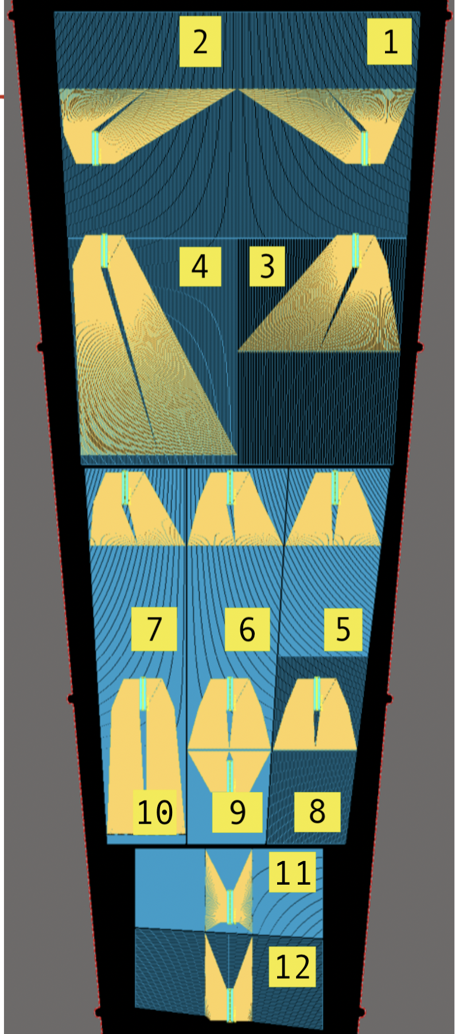
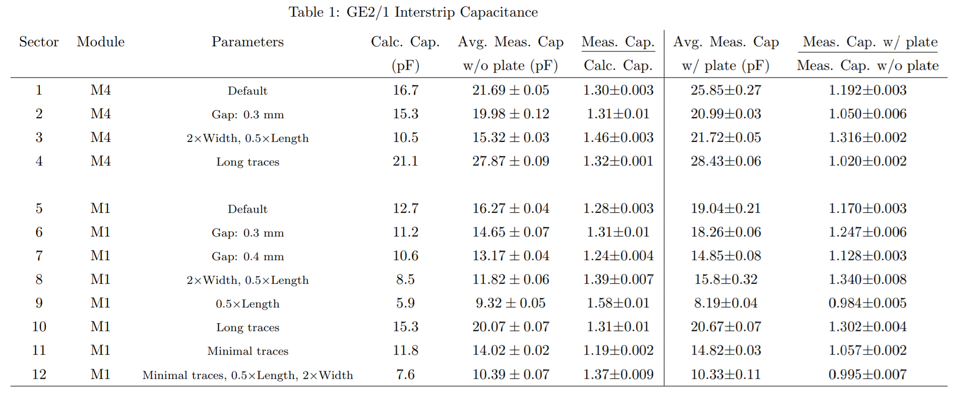
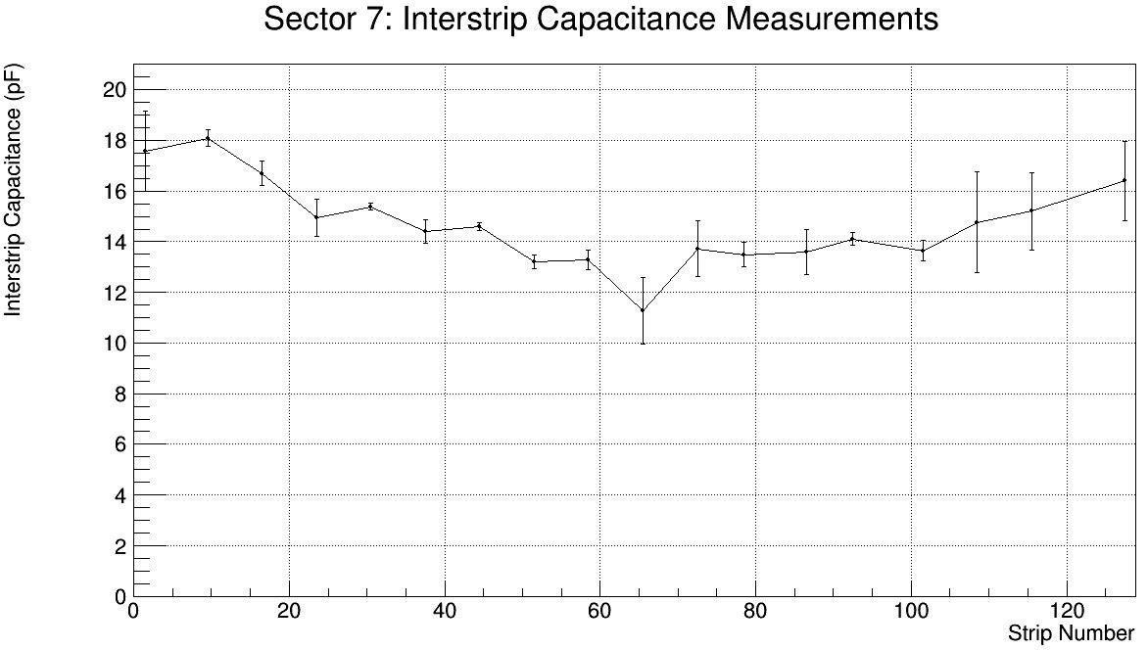
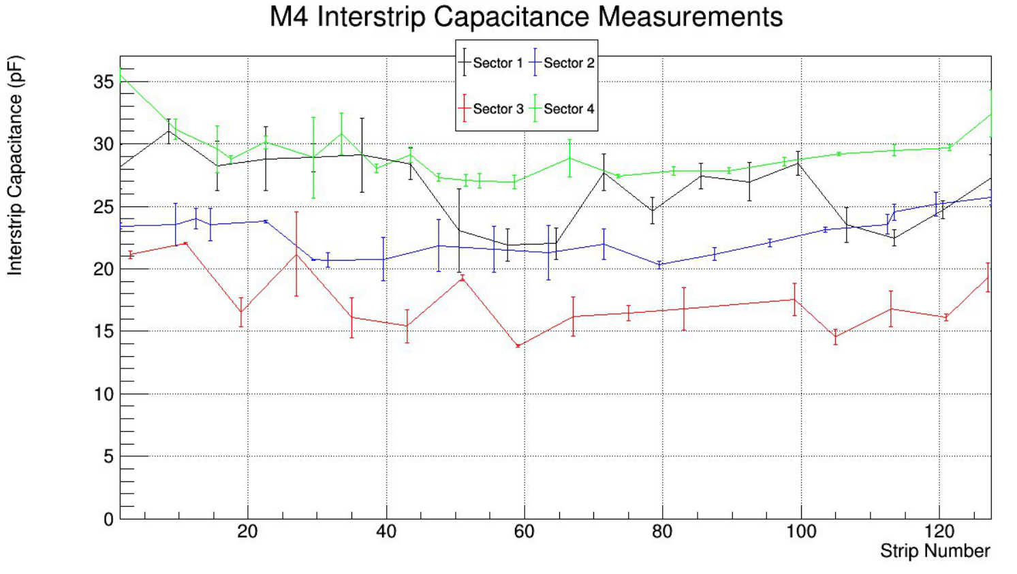
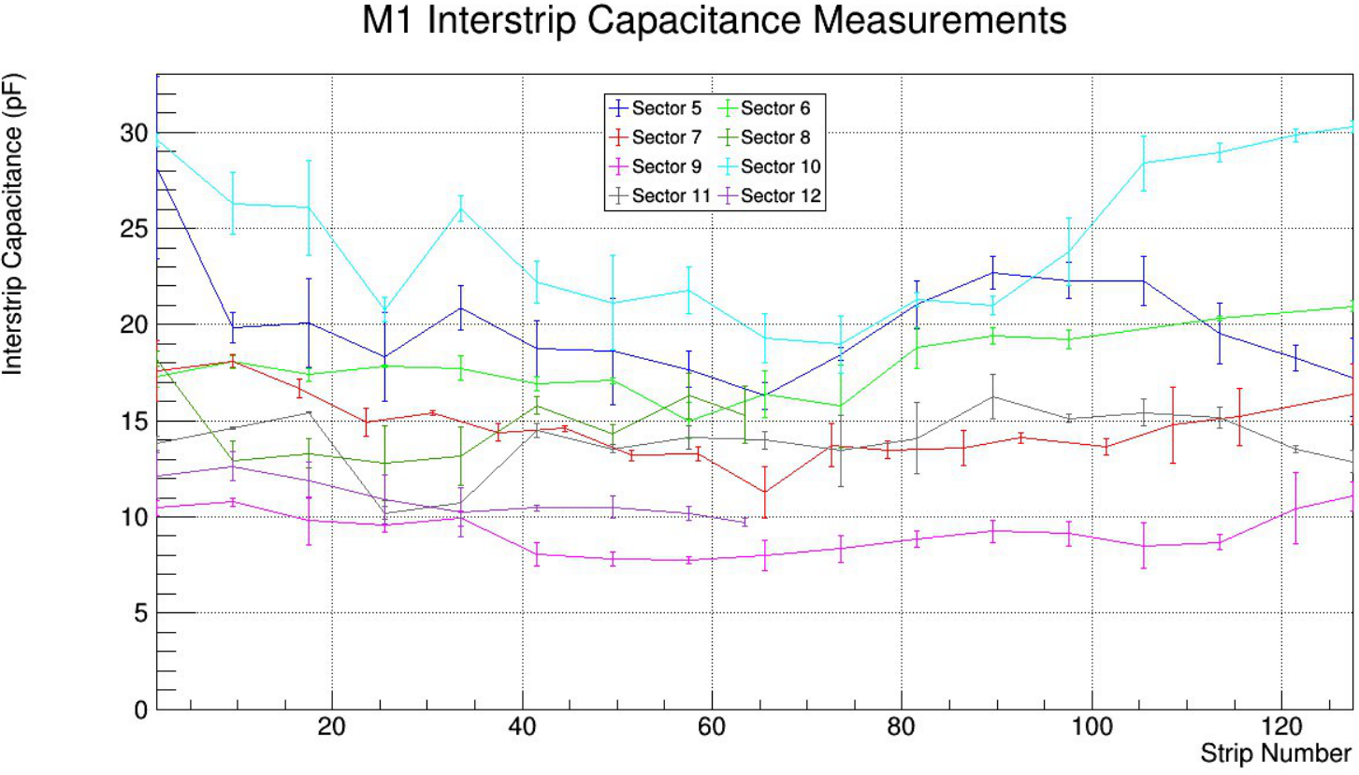
Calculation and Measurement of Interstrip Capacitance on the GE2/1 Prototype Detector
Alejandro Busto, Devkumar Roy, Liam Shaw, Joseph Weatherwax
Faculty Advisor: Dr. Marcus Hohlmann, Dept. of Aerospace, Physics, and Space Sciences, Florida Institute of Technology
Abstract:
Florida Tech received a prototype of the new GEM detector design from CERN. Analytical calculations were made to predict the interstrip capacitance of each strip pair, and capacitance measurements were taken with and without a simulate GEM 3 bottom. For M1 sectors, sector 9 had the lowest interstrip capacitance of 9.32±0.05pF. For M4 sectors, sector 3 had the lowest interstrip capacitance of 15.32±0.03pF.
Results:
For the Module 4 (M4) sectors, sector three had the lowest average capacitance of 15.32±0.03pF. For the Module 1 (M1) sectors, Sector 9 had the lowest average capacitance of 9.32±0.05pF.
The interstrip capacitances of sectors with double width and half height, sectors 3 and 8, were increased the most by the addition of the copper plane.
On some sectors the innermost strip pairs with shorter traces appear to have systematically lower interstrip capacitances than the outermost strip pairs.
Figure 1: The trace and strip pair geometries of the readout board [2].
Background:
The Phase II upgrade of the CMS will prepare the experiment for the high luminosity LHC. Without upgrading the muon system, the increased muon rate will saturate the L1 triggers. The second generation of GEM detectors, GE2/1, will serve as another measurement of the position and momentum of particles^{[2]}. The goal of improving any detector is to maximize the signal to noise ratio. The sector geometry that minimizes the interstrip capacitance will also minimize the noise and maximize the signal to noise ratio.
Table of Results
Figure 4: Sector 7 shows noticeable dip in interstrip capacitance in the middle of the sector
Conclusion and Further Work:
Sector 3 is the best design for M4 with a capacitance of 15.32±0.03pF (See Figure 3).
Sector 9 is the best design M1 with a capacitance of 9.32±0.05pF (See Figure 4).
The measurements agree with the calculations, but there is a 30% discrepancy resulting from the simplicity of the model^{[2]}.
Closed-form analytical solution for capacitance with GEM foil is doubtful, further work could include making a simulation to calculate theoretical interstrip capacitance.
Methods:
8-22 measurements were made in each sector with the copper plane using an Excelvan m6013 capacitance meter set to picofarad range (See Figure 1).
Measurements without the copper plane were obtained from the FAS presentation^{[1]}.
For each strip pair, one person held the capacitance probes 1 cm away from the strips, and another person zeroed the meter. The probes were placed on the two strips and the capacitance was recorded. This process was repeated 4 times for every strip pair.
A copper plane was added 1mm below the board to simulate the third GEM foil, and the measurement procedure was repeated.
A weighted average and standard deviation was calculated for each sector.
Figure 2: Interstrip Capacitance as a function of strip number for all M4 sectors.
Acknowledgments:
We would like to acknowledge Dr. Hohlmann’s guidance and assistance with this project, Ana Ovcharova (UCSB) for designing the prototype GE2/1 readout board, Jerry Collins, Angelo Lucciola, John Hammond, Stephen Butalla, and Michael Werbiskis for their help with the interstrip capacitance measurements.
Figure 3: Interstrip capacitance as a function of strip number for all M1 Sectors
References:
[1] S. Butalla & M. Hohlmann, "Calculation and Measurement of the Interstrip Capacitance on the Readout Board of the GE2/1 GEM Detector," 83rd Florida Academy of Sciences Meeting, 2019.
[2] CMS Collaboration, “The Phase-2 Upgrade of the CMS Muon Detectors Technical Design Report,” Technical Report CERN-LHCC-2017-012, CMS-TDR-016, CERN, 2017.

