Slide 1





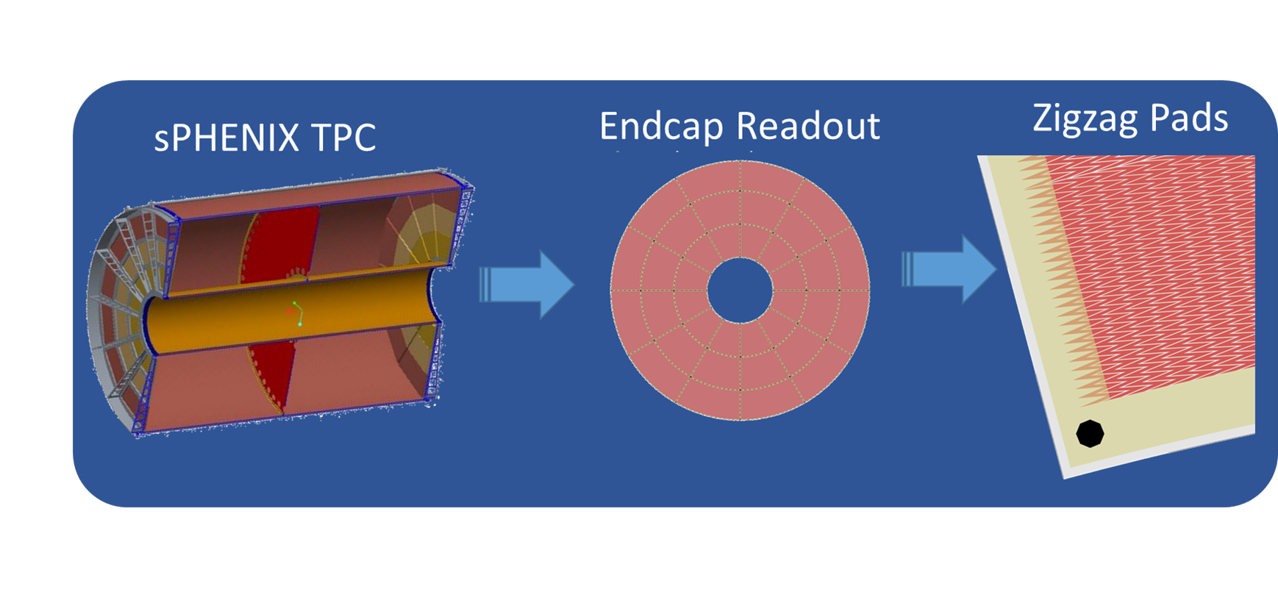
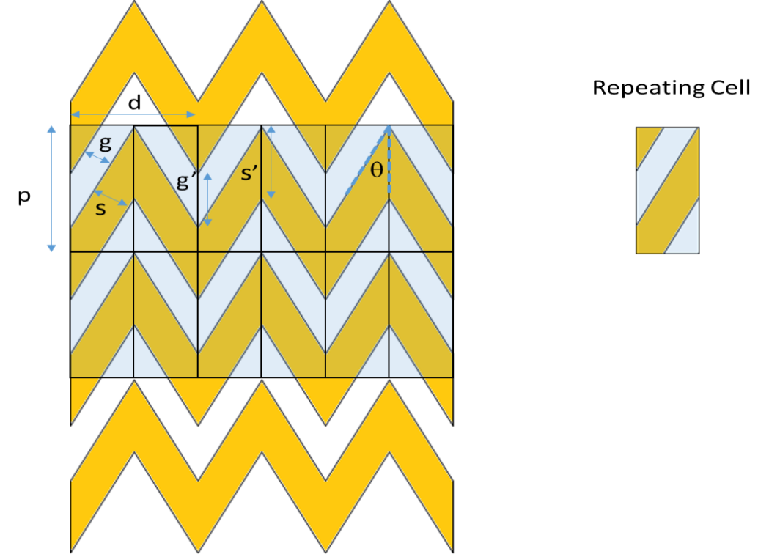
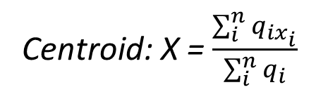
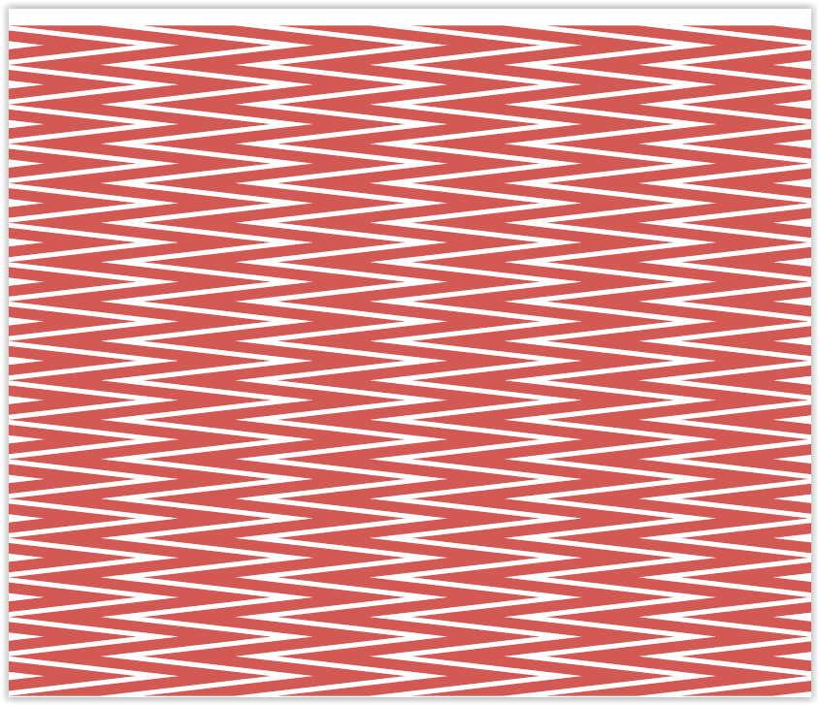
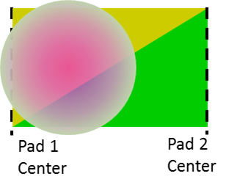
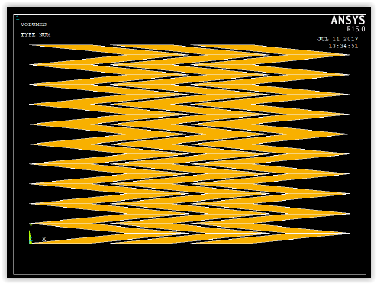
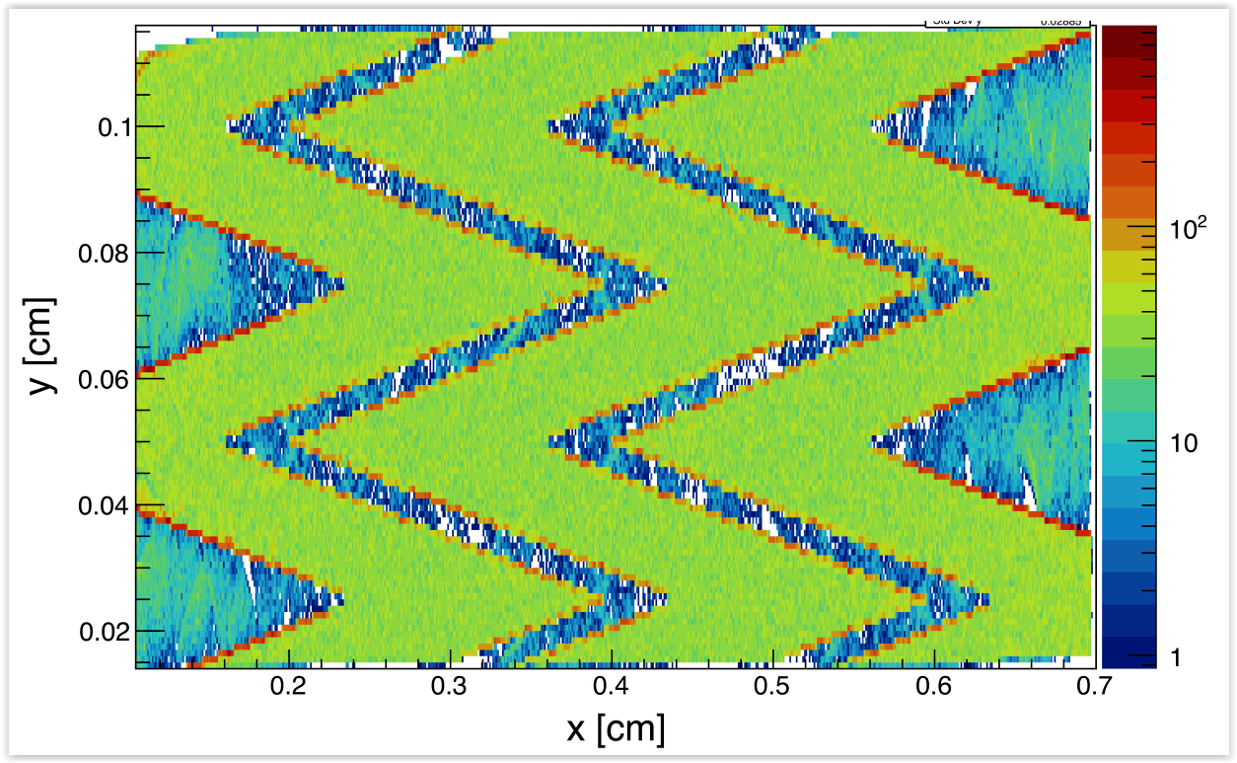
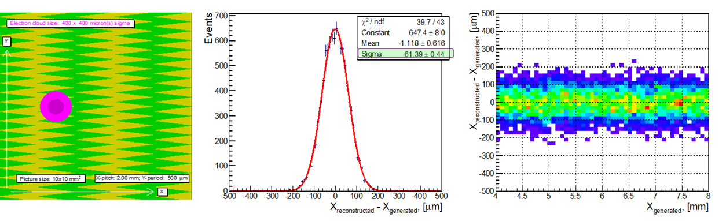
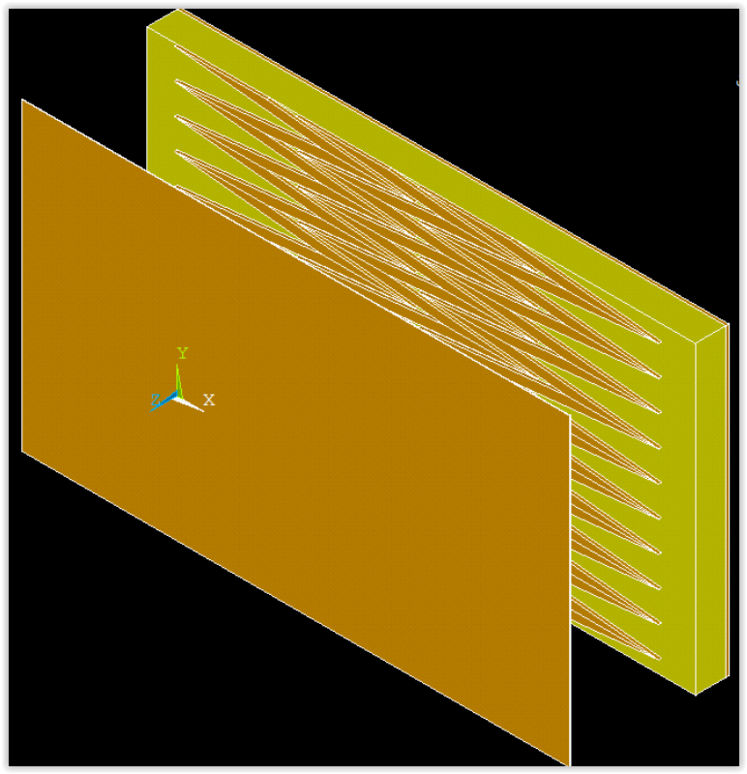
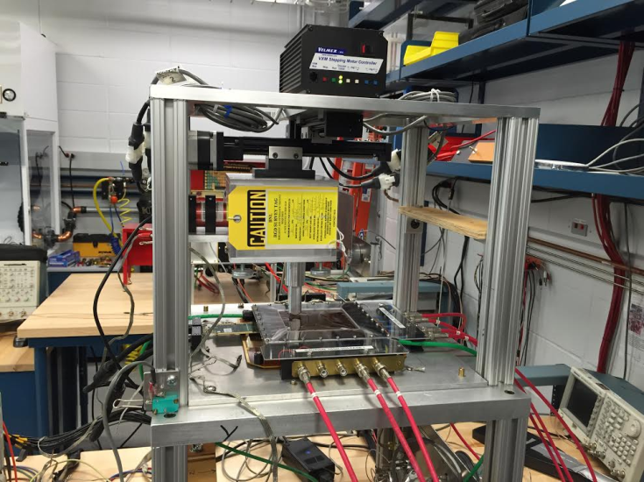
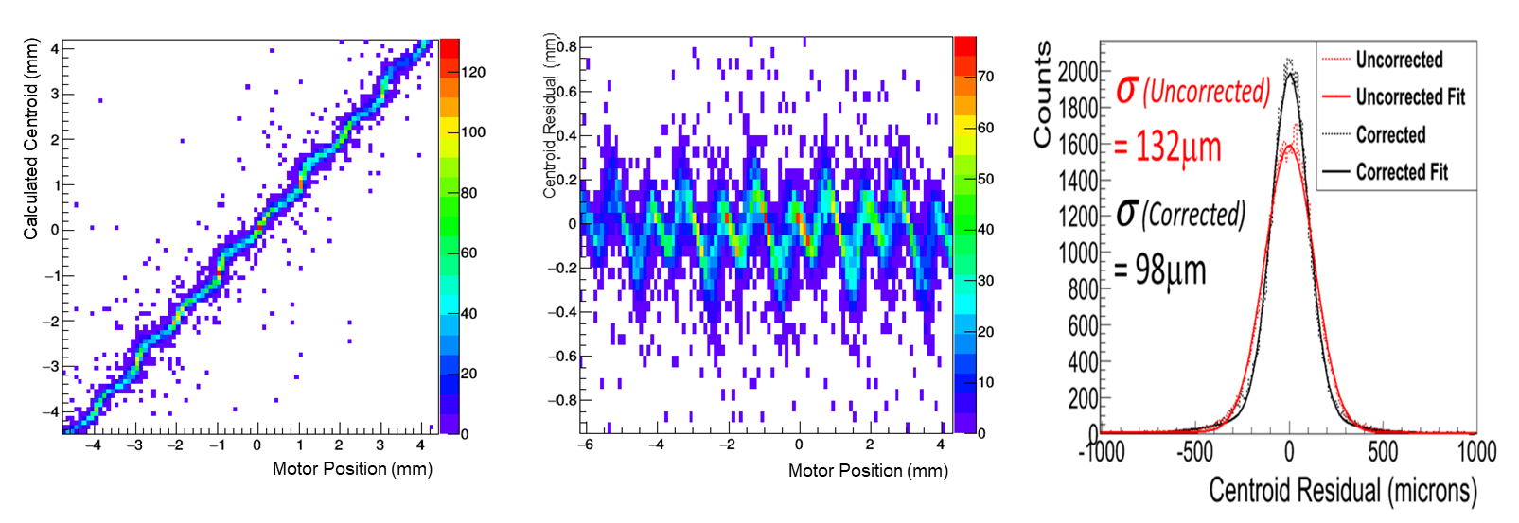
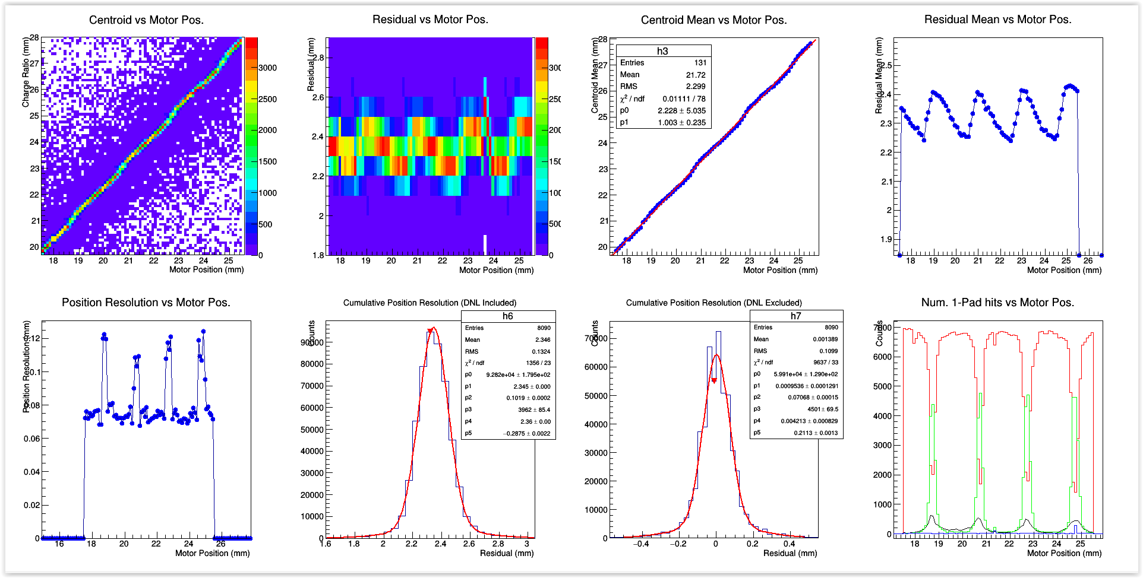
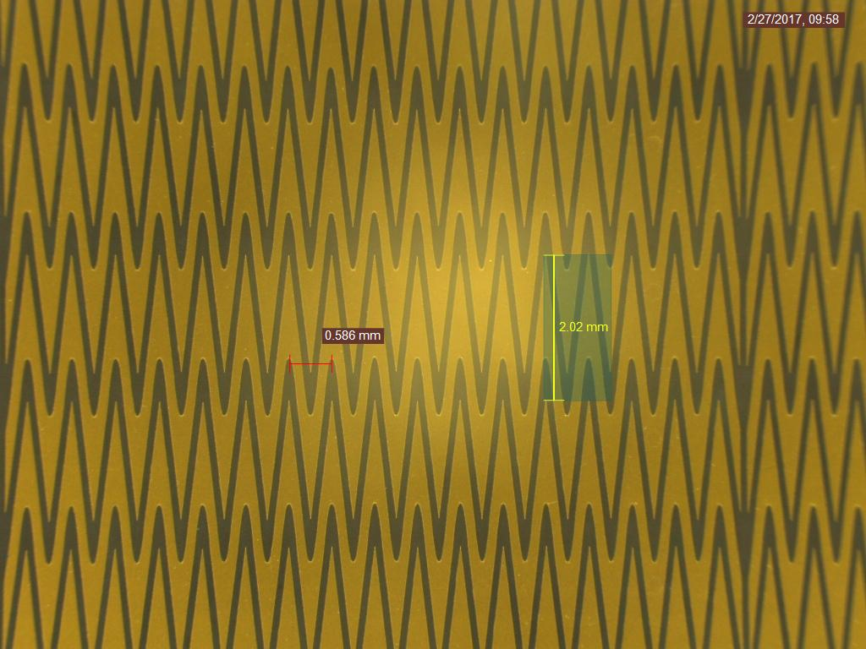
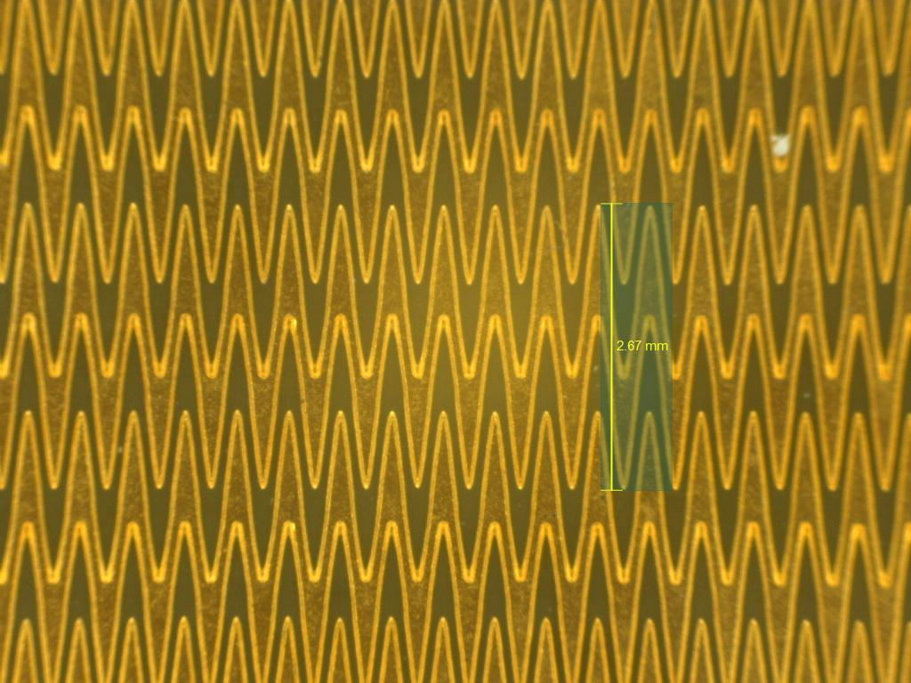
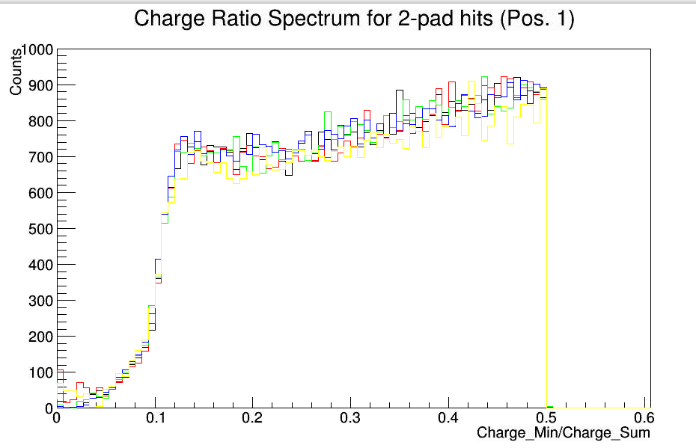
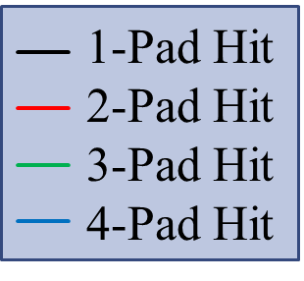
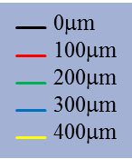
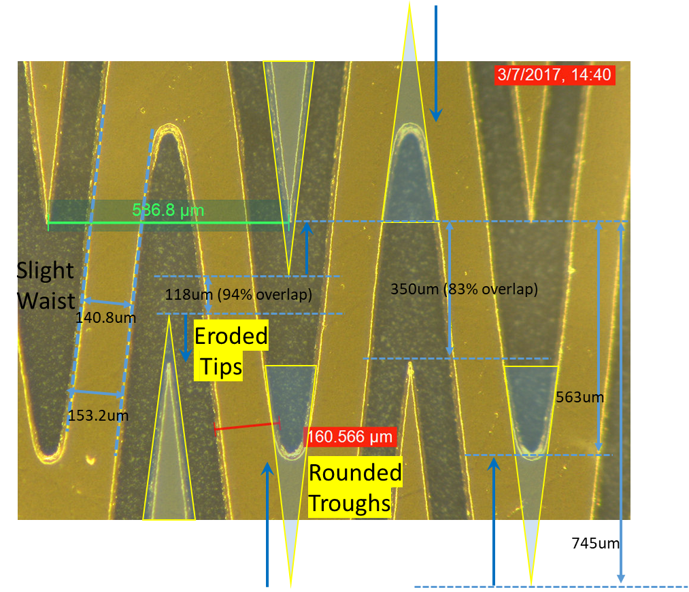



Design Studies for a TPC Readout Plane Using Zigzag Patterns with Multistage GEM Detectors
B. Azmoun¹, P. Garg³, T. K. Hemmick³, M. Hohlmann², A. Kiselev¹, M. L. Purschke¹, C. Woody¹, A. Zhang¹
¹ Brookhaven National Laboratory, Physics Department, Upton, New York, United States of America
² Florida Institute of Technology, Department of Physics & Space Sciences, Melbourne, Florida, United States of America
³Stony Brook University, Department of Physics and Astronomy, Stony Brook, New York, United States of America
INTRODUCTION
A Time Projection Chamber (TPC) is currently under development for the sPHENIX detector at RHIC. It
will be read out using a multi-stage GEM detector at each endcap, with a pad-plane consisting of 40 pad rows in radius. A critical performance goal for the readout is to achieve a minimal single point spatial resolution of ~200μm. In order to meet this requirement with minimal channel count and cost, we propose segmenting the readout into zigzag-shaped pads with a pitch of about 2mm and a length of about 1cm. The interleaving tips of the zigzags enhance .
sharing between neighboring pads and allow the possibility to interpolate the hit position to a precision many times better than the physical extent of the pad itself.
Here we discuss various simulation studies that were employed to optimize the size and shape of the zigzag pattern, along with the challenges in fabricating the corresponding PCB’s. Finally, results will be presented of a prototype zigzag PCB studied in the lab.
Motivation: Linear Charge Sharing Model
Attributes:
Charge sharing is directly proportional to hit position as long as the pitch and period are chosen appropriately for the size of the charge cloud
The pad response is independent of charge cloud size over a relatively broad range of sizes
2-3 pads are needed for the centroid calculation; additional pads tend to deteriorate linearity
Ideally, a single strip does not take more than ~80% of total charge
Ideally, the pad response is independent of hit position, with a differential non-linearity (DNL) ~ 0
Single pad hits should be minimized to ~ 0
In principle there are no limiting factors for the achievable position resolution due to the use of ideal ZZ pads, other than practical issues like signal to noise ratio, etc
An optimized pad design avoids corrections for a DNL, which are never 100% efficient
Zigzag Geometry
Zigzags Vs Std. rectangular pads
Charge sharing among neighboring pads
6 Zigzag pads, 2mm pitch
6 Rect. pads, 2mm pitch
Ideal pad:
zero space-gap
Pad width
No overlap
Hit position of charge cloud
Charge cloud
Zigzag overlap
Tip-toTip Distance
Parameter | Definition
p (defining) | ZZ pitch
d (defining) | ZZ period
s (defining) | Trace width
g (defining) | Gap width
s’ (secondary) | Trace width (apex)
g’ (secondary) | Gap width (apex)
θ (secondary) | ZZ angle
$$δ_{x}≈\frac{S}{N}\& DNL$$
(Assuming no single pad hits, which
is an ideal feature of zigzags)
$$δ_{x}= \frac{Pad Pitch}{\sqrt{12}}$$
(For single pad hits)
The ideal geometry of zigzags offer a scheme to split charge in proportion to hit position, while allowing the pad to extend well beyond the pitch – typically the pad extends two times the pitch.
For the same pitch, zigzag shaped pads have clear advantages over standard rectangular pads.
Simulations
Charge collection simulation, dictated by the simple geometry of the zigzag pattern
An ANSYS simulation of the electric field in the gap above the zigzag pads and a simulation of gas processes like diffusion are used together to track a uniform plane of electrons onto the pad plane
Coarse Zigzag
Non-uniform response, ie large DNL
Poor spatial resolution
Single pad hits, ie Non-sensitive areas
Residual Distr.
Residual Vs. hit position
Density of collected electrons
Highly Interleaved
Zigzag
Uniform response across pad plane,
No “dead zones”
Very good spatial resolution
~60mm
N/S ~2%
The collection of electrons onto the zigzag pads is done in a quite uniform way, so the electric field does not impose any significant non-uniformity during the collection process
Generally, the pitch and the degree of interleaving of the zigzag tips determine the level of charge sharing uniformity, where the zigzag period can influence the “flatness of response
As can be seen below, the more practical parameters like trace and gap width play a significant role with regard to the actual achievable resolution
Measurements
Old PCB/Design Scan Results
Counts
Performance improvements (New Vs Old PCB):
  Reduced DNL (more homogeneous response)
  Improved resolution (70/100μm Vs 98/132μm)
  Far fewer single pad hits (few% Vs 30%)
While the in-lab measurements of resolution may be used to attach figures of merit to each zigzag pattern, these measurements are not fully representative of the single point track resolution in the TPC, therefore the goal is to simply maximize, to a reasonable extent this relative measure of the resolution.
In general, the performance is hindered by practical matters like S/N, cross talk, gain uniformity, FEE dynamic range, specific E-field distortions, and fabrication limitations on gap widths, etc.
Scanning X-ray Gun (Collimated)
4-GEM w/ Zigzag
Readout (ArCO2 (70/30))
A slit collimated beam of x-rays (~50μm x 8mm) scans across ZZ readout, coupled to a 4-GEM stack
Note: the resolutions quoted here do not have the beam width unfolded, since the width is not precisely known
New PCB/Design Scan Results
Centroid Residual (μm)
Perpendicular Scan
Collimated x-ray
Line Source
Single Pad Hit zone
Slope ~1
ZZ period
By scanning perpendicularly, the uniformity of the pad response may be checked across the ZZ period
ZZ pitch
ZZ pitch
σ ~100μm
N/S ~1-3%
σ ~70μm
N/S ~ 1-3%
Min charge ~10%
Old PCB/Design
New PCB/Design
Biggest improvements in new PCB design include increased interleaving and reduced single pad zone
Charge ratio spectra at 5 points within a 500mm ZZ period
Measured physical ZZ Parameters | p (mm) | d (mm) | s (mm) | g (mm) | Strip Overlap / Pitch (%) | Gap / Pitch (%) | Electrode Area / Tot. PCB Active Area (%)
Old Design/PCB | 2.00 | 0.5 | 0.159 | 0.082 | 69.0 | 4.1 | 66.0
New Design/PCB | 2.00 | 0.586 | 0.141 | 0.084 | 82.5 | 4.2 | 63.0
Spectra at all five points have the same shape → uniform pad response across ZZ periods
Smallest charge for a fired pad is ~10% of total collected charge
SUMMARY AND CONCLUSIONS
In large part, these results were able to validate the fundamental concepts behind the charge sharing model described above. This is seen by the improved performance of the newer board compared to the older one. However, the new board is still far from ideal. In fact the fabrication process imposes some real constraints on the deliverable geometric parameters of the zigzag pattern. For the new PCB, the larger feature sizes, including the zigzag pitch and period were reproduced quite accurately by the manufacturer, however the smaller features like the trace and gap width had a margin of error approaching 5-10%. In particular, the zigzag geometry was distorted by both the over-etching of the zigzag tips and the trace width and by under-etching the zigzag troughs. The over-etched tips resulted in reducing the pad overlap from 94% in the design to 82% for the fabricated PCB. In addition, the area occupied by the copper conductor was diminished from 67% to 63%.
We plan to continue the development and optimization of the zigzag pads, with a focus on pursuing
Zigzag Distortions
Critical items:
The over-etched tips may substantially diminish the performance of the PCB (vis-a-vis reduced charge sharing)
Gaps larger than the design spec. and trace widths narrower than the design spec. will also impact the performance by reducing the amount of copper conductor covering the active area, possibly contributing to non-linear charge sharing
more accurate fabrication methods. In particular, a laser etching process is available at reasonable cost, which seems to be among the most accurate fabrication techniques available on the market. Feature sizes down to about 25mm (~1mil) are possible with this technique, far out-performing the specifications of traditional chemical etching. Thus we plan to have new PCB’s made using this process which provides smaller gaps between zigzag pads and increased pad overlap, for potentially improved performance.
This work was supported by the U.S. Department of Energy under Prime Contract No. DE-ACO2-98CH10886.

