Slide 1
Large GEM Detectors for
Tracking at Forward Rapidities
RHIC Spin Collaboration Meeting
Forward Spectrometer Hardware
BNL – March 9, 2017
Marcus Hohlmann
Florida Institute of Technology

Slide 2
Outline
GEM principle
Large-area GEMs in experiments
  EIC detectors
  CMS forward muon upgrade
R&D on large-area GEMs for EIC
  Construction techniques
  Prototype designs and performances
Outlook

Slide 3
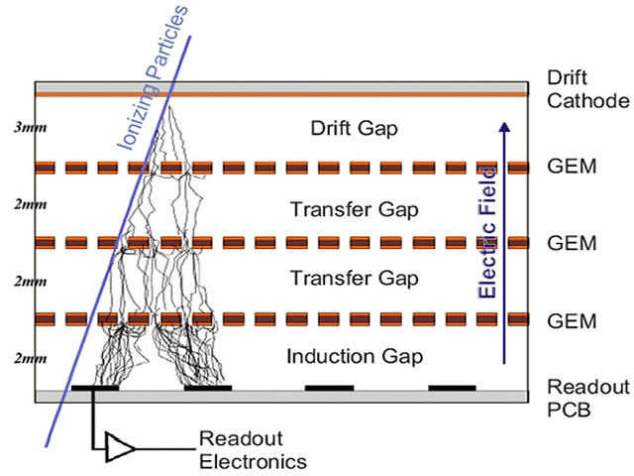
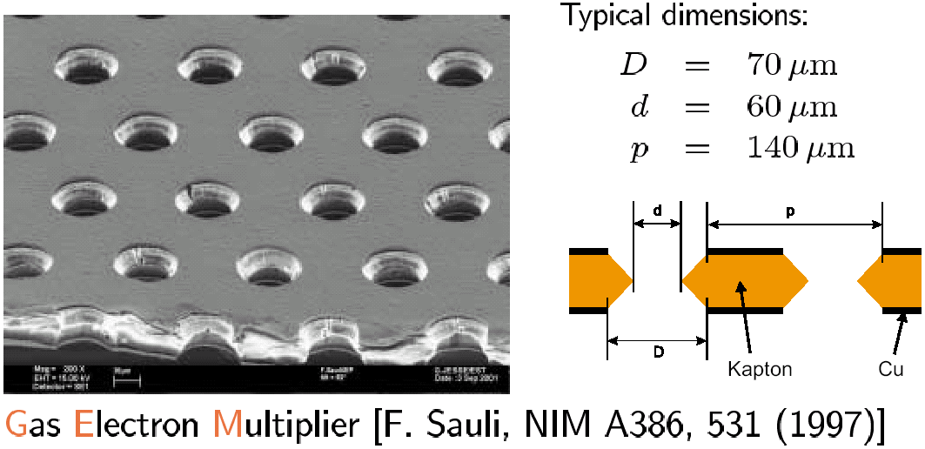
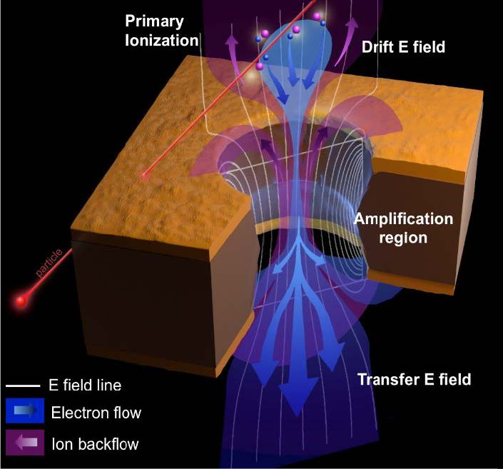
GEM Principle
Triple-GEM
detector
Detector volume filled with
e.g. Ar/CO₂ 70:30 gas mixture
Ar+
CO₂+
e-
Micro-pattern gas detector (MPGD)
-
300 – 500 V (on each GEM)
1cm
+
Anode strips
CMS GEM upgrade TDR

Slide 4
Large-area GEM Uses
Examples in Nuclear and High Energy Physics:
ALICE
  TPC upgrade
CMS
  Forward muon upgrade
PRad
  XY tagger for calorimeter
Super Big Bite
  Main tracking
EIC detectors
  Forward tracking
GEMs are usually considered
“large” if they are > 1m long.
~

Slide 5
Large GEMs for EIC Detectors
All proposed EIC detector concepts feature a form of large GEM tracker at forward and backward rapidities:
ePHENIX
JLAB IP1
BeAST
R&D effort dedicated to EIC forward tracking since 2011:
Florida Tech & U. Virginia (eRD6), Temple U. (eRD3)

Slide 6
CMS Forward Muon Upgrade
Large GEMs were originally developed at CERN for the CMS forward muon upgrade project:
R&D program 2009-17 (with Fl. Tech participation)
  Mastering of single-mask etching of Cu-Kapton base material made GEMs larger than ~ 30 cm × 30 cm feasible
  Mechanical stretching and assembly of GEM foils makes internal spacers obsolete & allows re-opening of detector if needed (no gluing).
  Ten full-size GEM detectors installed in 2017 (slice test)
Technical Design Report for GEM upgrade in first muon station for High-Lumi. LHC approved 9/2015
Currently preparing mass production of 160 GEM detectors & second TDR for two other muon stations

Slide 7
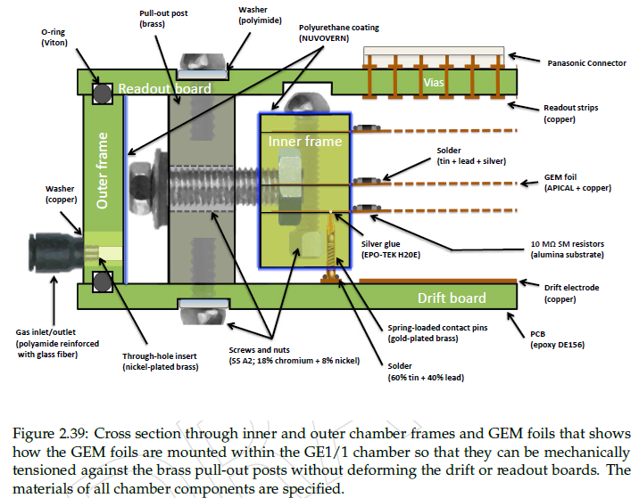
CMS GEM – Mechanical Construction
Purely mechanical assembly and GEM foil stretching:
(steel)
Readout PCB
3 large GEM foils
in a stack
No spacers
Drift PCB
CMS GEM TDR (CERN LHCC-2015-012)

Slide 8
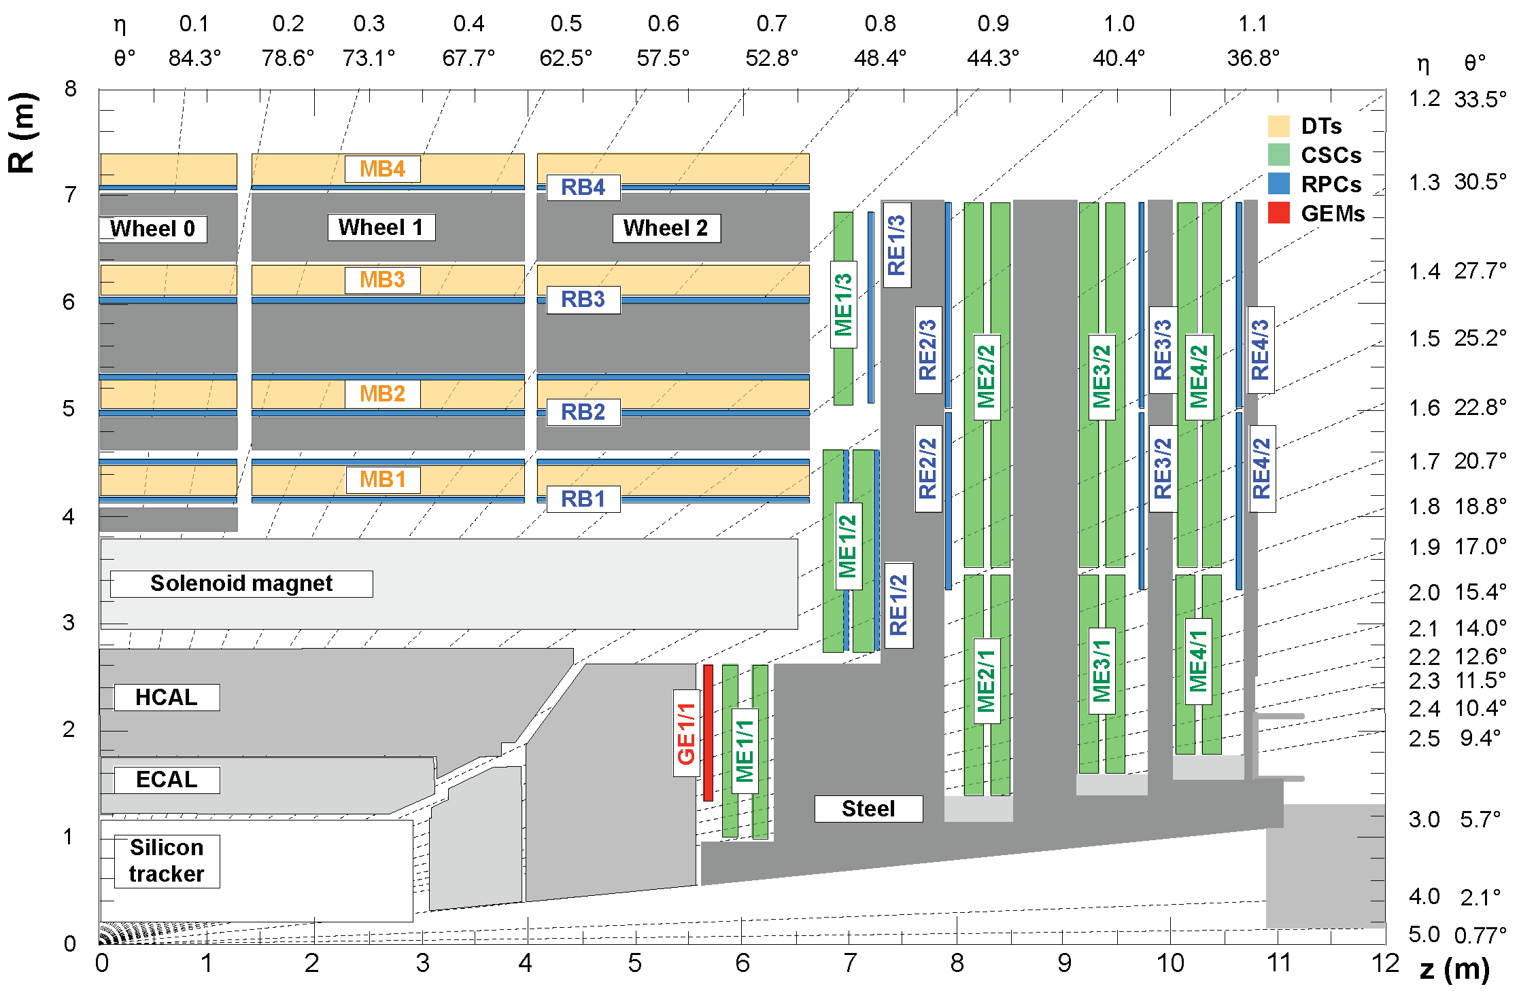
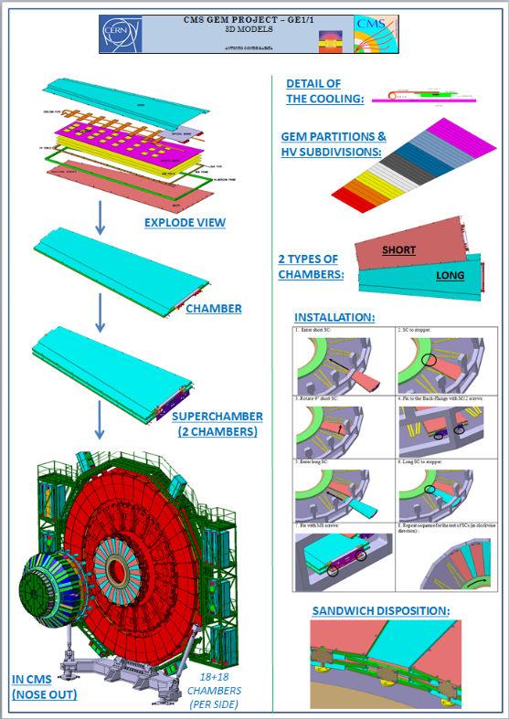
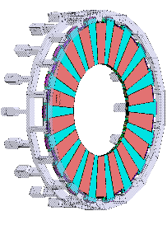
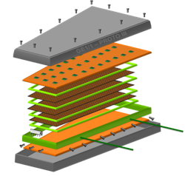
CMS GEM Upgrade
  “GE1/1” GEM subsystem in region 1.5 < |η| <2.2
  10⁰ trapezoidal triple-GEM Superchambers (2 ch.)
  Long and short versions (1.5 or 1.6 < |η| <2.2)
  36 superchambers in each endcap
Muon
Endcap
Station 1
Muon
Endcap
Station 1
GE1/1
Chamber
10º
superchambers
short
long
Front-end
Installation planned for 2019

Slide 9
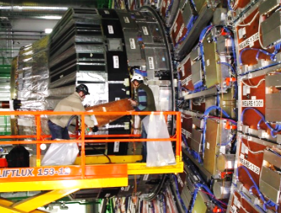
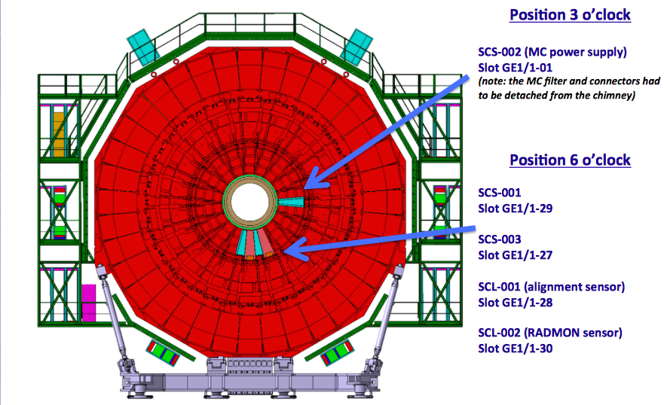
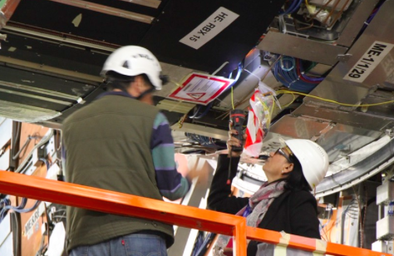
CMS GEM Slice Test Installation
Commissioning
currently ongoing:
- Gas, HV on
- Electronics
powered
January 2017
Muon
Endcap
Station 1

Slide 10
EIC GEM R&D: Construction
The three eRD3/6 FT groups are investigating different detector construction techniques:
Constructing detector purely mechanically & without any spacers as in CMS (Florida Tech)
Gluing stretched foils to FR4 spacer frames that are then mechanically assembled (U. Va.)
Gluing entire detector and inserting kapton rings between GEMs as spacers (Temple)

Slide 11
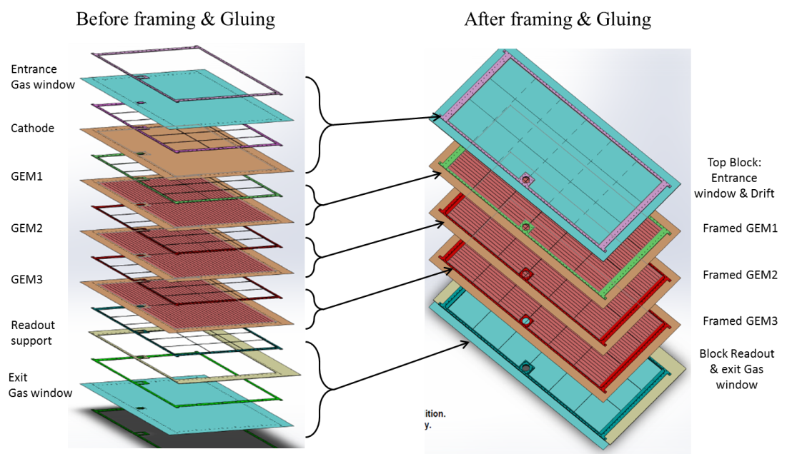
Assembly with Bolted Spacer Frames (U. Va.)
Bolts and O-ring to
seal the chamber
spacers
High strength material frame
Light material G10 as
GEM support frames
Example: Exploded 3D view of PRad GEM design
Chamber's characteristics
Low material in active area
No honey comb support but keep spacers
Light material for GEM frames
High strength material for external support frames
Bolts & O-ring to seal the chambers
Courtesy Kondo Gnanvo, U.Va

Slide 12
Assembly with Glued Frames (Temple)

Slide 13
EIC GEM R&D: Readout
The three eRD3/6 FT groups are investigating also different signal readout techniques:
2D-readout with U-V strips (U. Va.)
2D-readout with R-φ readout strips (Temple)
1D-readout with radial zigzag strips that minimizes the number of strips and electronic channels to minimize cost while maintaining good spatial resolution (Florida Tech)

Slide 14
First U-V Readout Prototype (U. Va.)
Courtesy Kondo Gnanvo, U. Va.

Slide 15

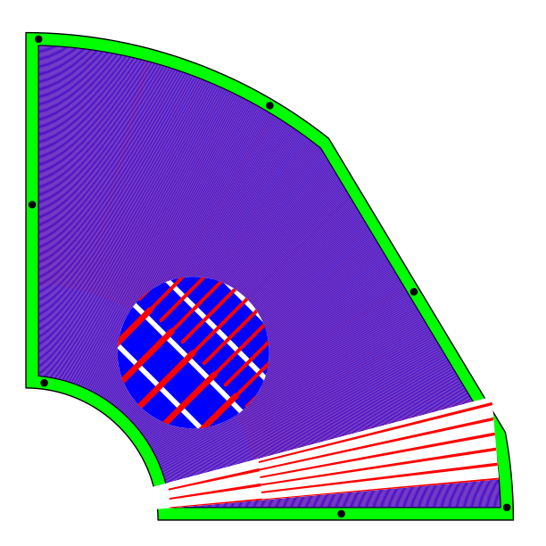
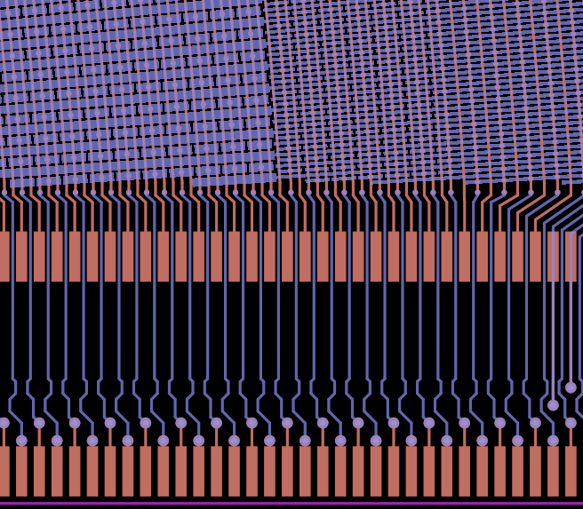
R,φ-strip Readout Design (Temple)
2D strips in R and φ coordinates. Implemented as strip-pad design with vias.
Based on
STAR FGT
Courtesy Matt Posik, Temple U.

Slide 16
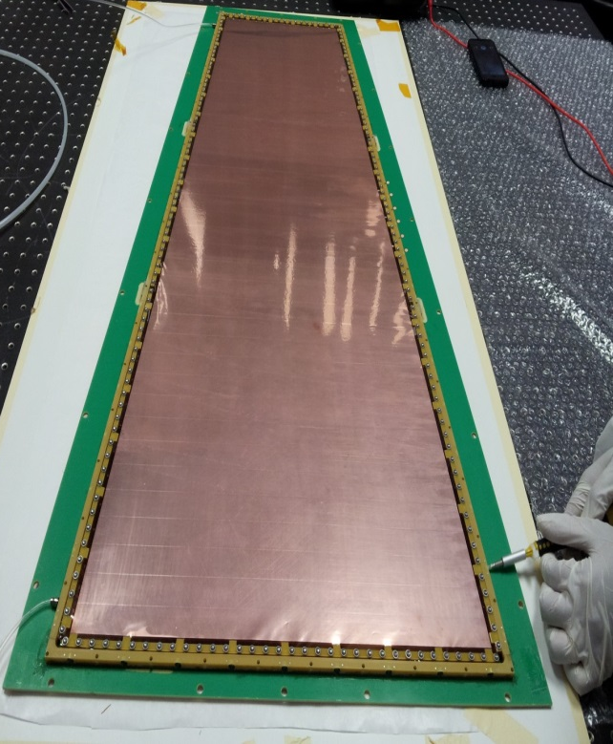
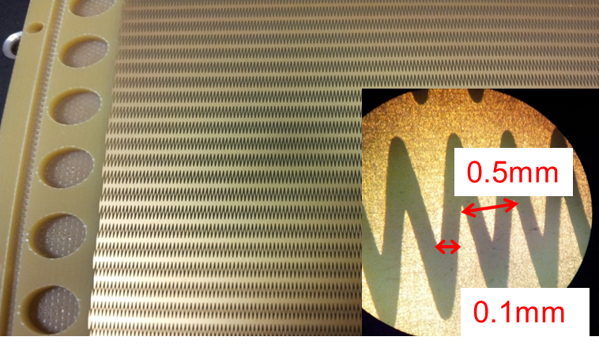
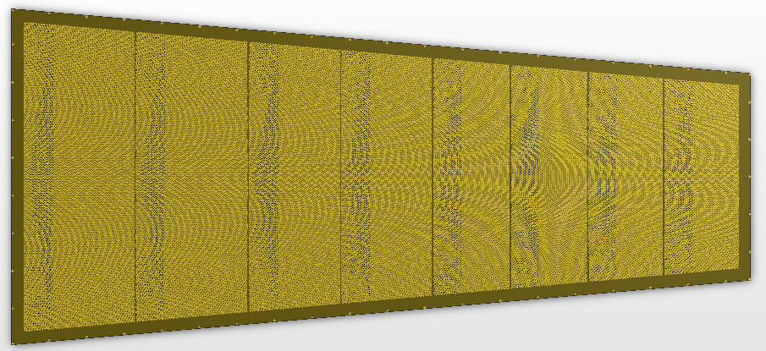
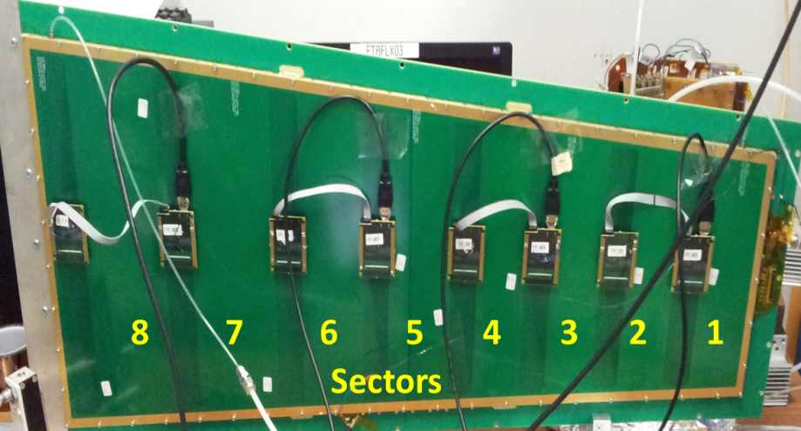
First Zigzag-strip Readout (FIT)
Radial zigzag strip
design
Produced zigzag strip PCB
1 m
GEM assembly
(foils on drift PCB)
CMS GEM detector equipped with a readout with radial zigzag strips on a PCB
Number of strips and readout channels are reduced by factor 3 relative to CMS readout
Zigzag strips cover radial range R ≈ 1.6 - 2.6 m in 8 eta sectors
Azimuthal strip angle pitch of 1.37 mrad; 128 strips per sector
Prototype tested in beam at Fermilab (2013)
Performance: Angular resolution of ~193 µrad (362 µm at R = 1.88 m)
NIM A 811 (2016) 30

Slide 17
EIC GEM R&D: Mult. Scattering
The three eRD3/6 FT groups are investigating methods to reduce overall detector material:
Remove or reduce Cu on GEM foils (U. Va.)
Replace solid drift and readout PCBs with carbon fiber composite frames (Florida Tech)
Reduces multiple scattering of tracks in the GEM detectors. Helps with:
matching electron tracks to EM cluster
seeding RICH ring reconstruction from incidence of hadron tracks on the RICH

Slide 18
EIC GEM R&D: Next Prototypes
Adjust the GEM detector geometry to accommodate the geometry of an actual EIC forward tracker:
      R = 8 – 98 cm radial coverage
      Δφ = 30.1º azimuthal coverage
EIC R&D group designed a 1-m scale common GEM foil, which satisfies the requirements of all three assembly techniques to save cost
8 GEM foils were produced at CERN and delivered to Florida Tech and U. Va.

Slide 19
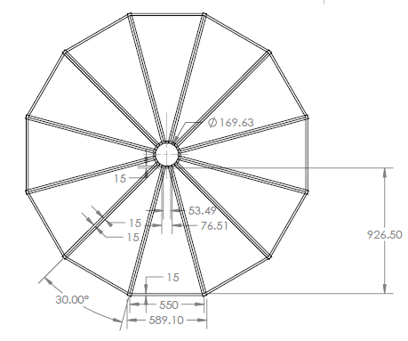
Overall EIC FT Geometry
Design for an
EIC forward tracker disk composed of 12 such trapezoidal GEM detectors
Active areas of chambers overlap
due to 30.1º chamber design.

Slide 20
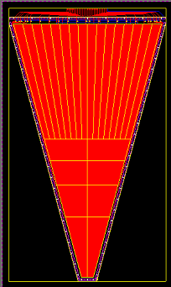
Common EIC GEM Foil Design
Foil width (at the large R end) is limited to 560 mm due to material limit of 610 mm
25 mm margins needed for foil production
Trapezoid with a length of 903.57 mm, widths of 43 mm and 529 mm (active area).
Active area is divided into 8 HV sectors in R direction at inner R and 18 HV sectors in azimuthal directions at outer R. Reduces energy of any potential discharges.
Each HV sector is ~100 cm² and gaps between sectors are 0.1 mm.
HV connections are made at wide end
903.57 mm
HV sectorization
30.1º
opening angle
GEM foil produced at CERN
560 mm (available design width)
610 mm (base material)

Slide 21
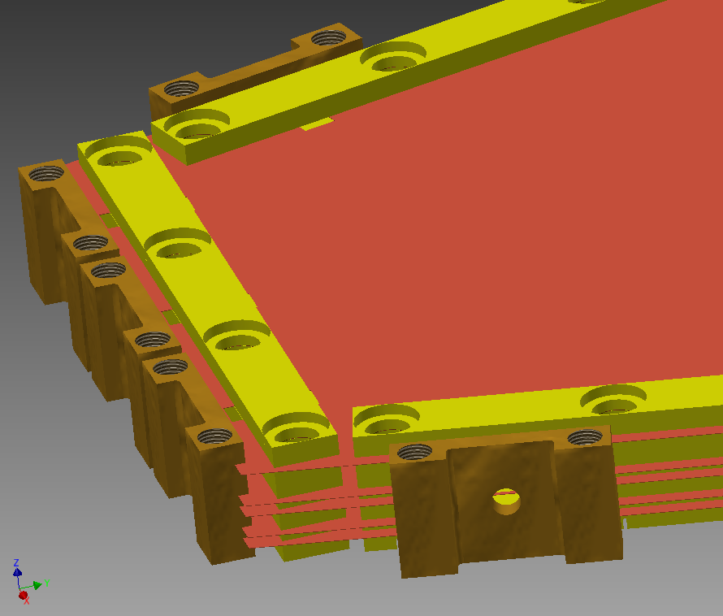
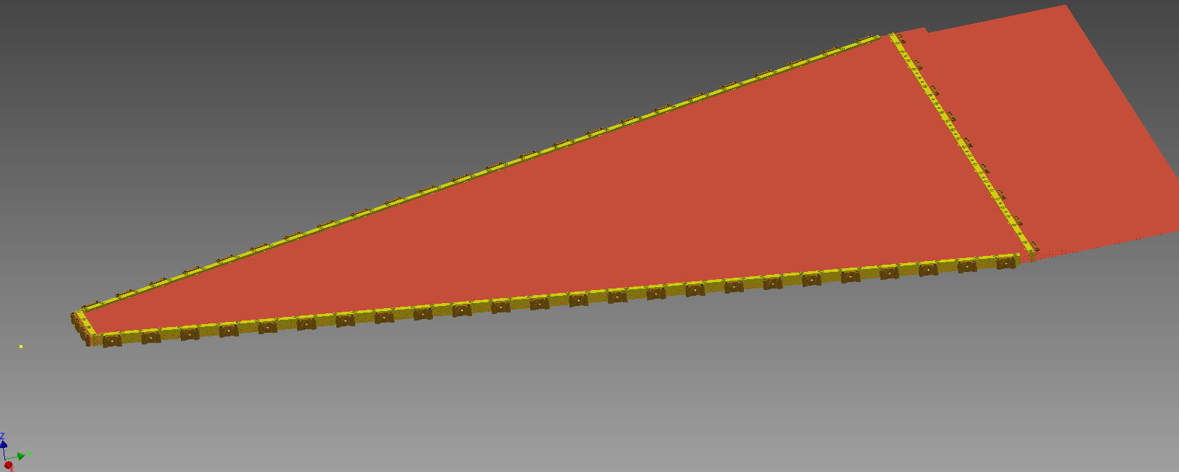
Modified Mechanical Stretching (FlT)
5-foil stack
Stack of 5 foils (3 GEM foils, 1 drift foil, and 1 readout foil)
No spacers

Slide 22
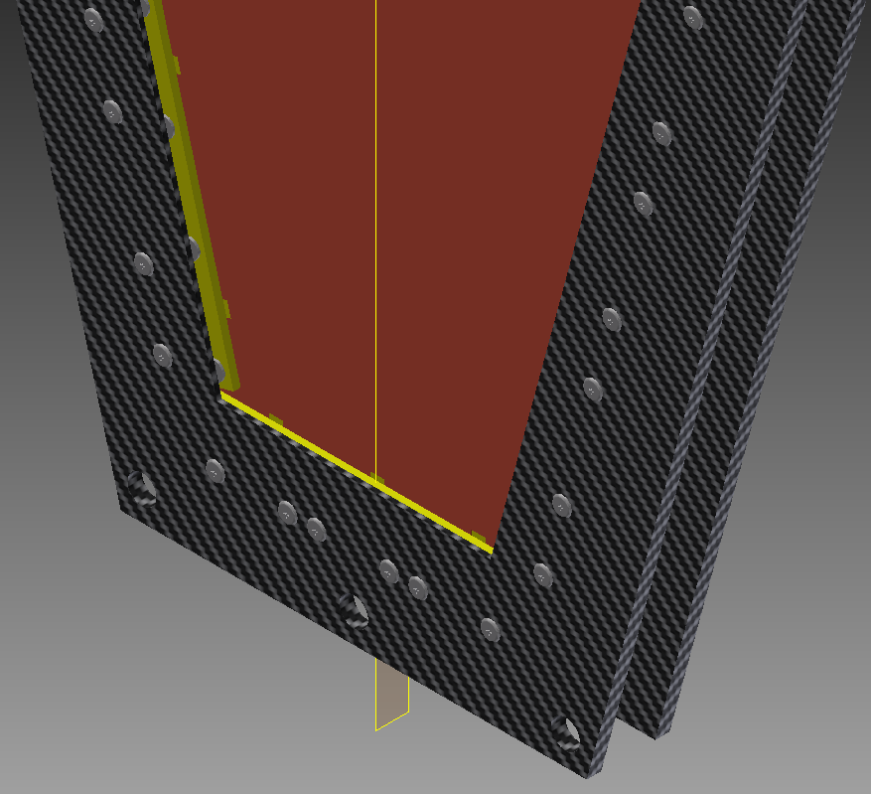
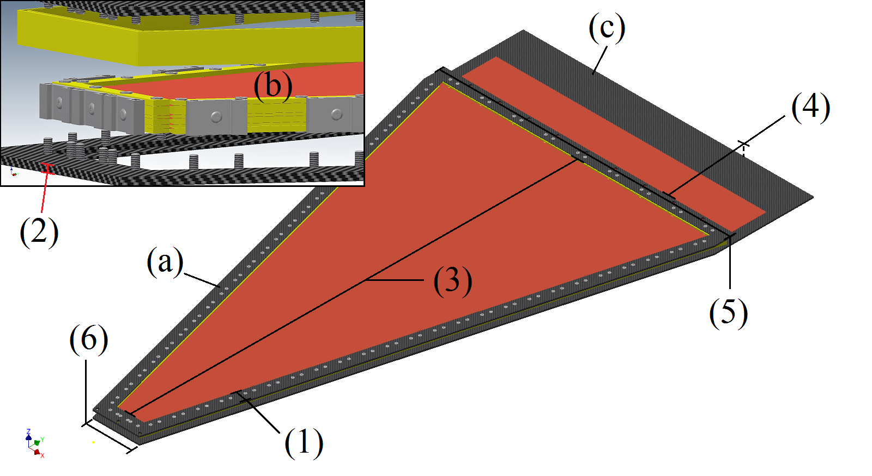
Carbon Fiber Frames (FIT)
5-foil stack
Gas seal frame
5-foil stack
Carbon fiber frame
Exploded assembly view
Assembled detector
Carbon fiber frames
Mechanical support structures are outer frames with windows (e.g. aluminized mylar foil, not shown here) instead of solid PCBs to reduce radiation length in the active area
Frames are made from carbon fiber composites that have high strength to take up the tension from the stretched foils

Slide 23
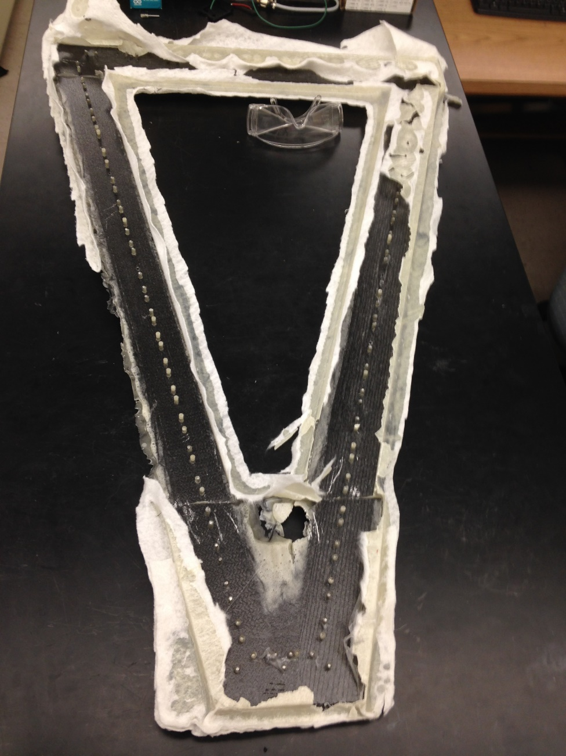
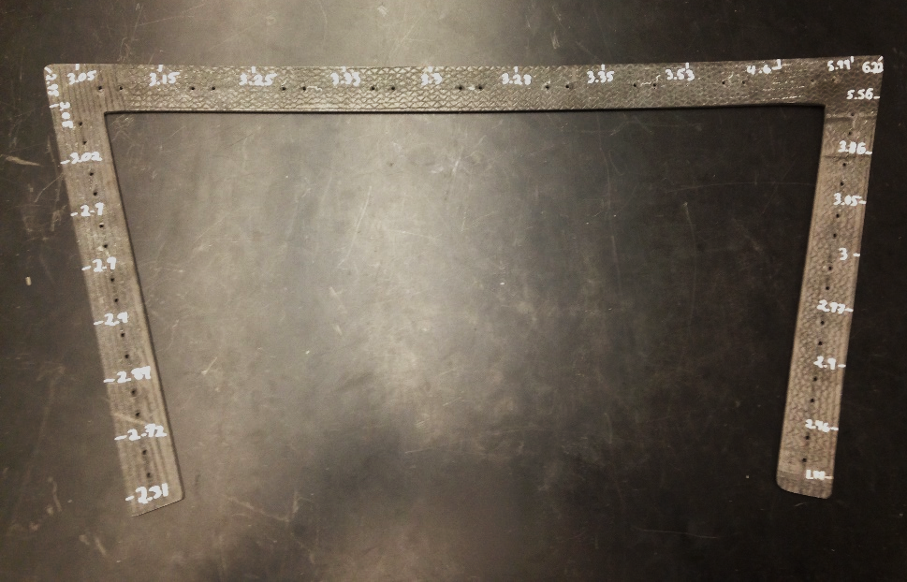
CF Composite R&D (FIT)
Trimmed quarter-frame (test piece, 175 g)
Carbon Fiber Composite:
Araldite epoxy (AY103)
Intermediate-modulus uni-directional
carbon fiber (“IM7”)
8 layers
Produced in-house
Raw full drift frame before trimming

Slide 24
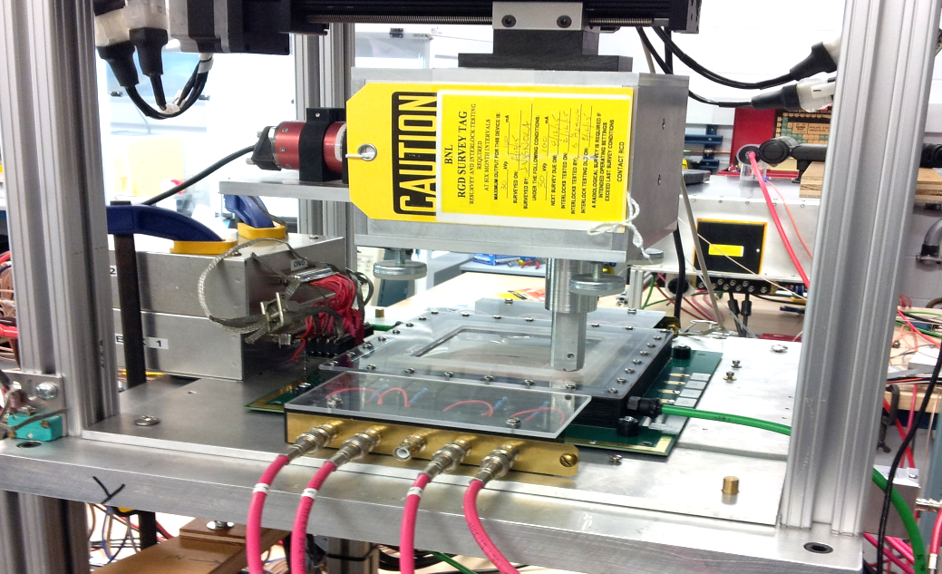
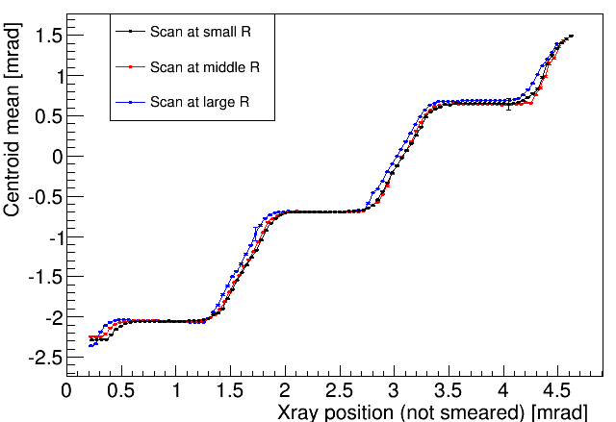
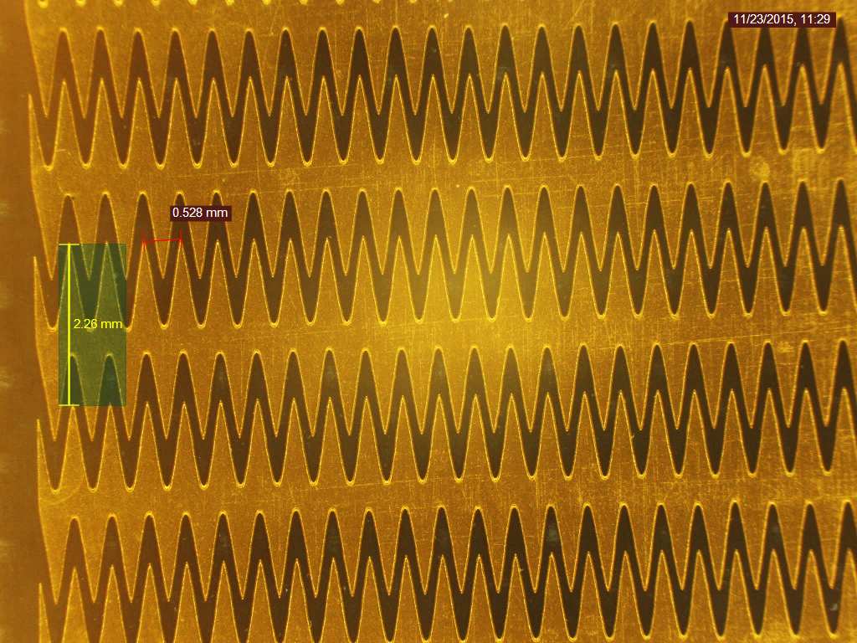
Non-linearity of First Zigzag Readout
2D stage and highly collimated X-ray gun at BNL
Reconstructed position vs. X-ray position (azimuthal)
Scans across strips at 3 different radii
Overetching of tips and underetching of valleys of zigzag strips creates “spines” along strip centers
GEM avalanche induces signal only on single strip
Without charge sharing among adjacent strips:
  Readout is insensitive to hit positions near the strip centers
  Overall spatial response is non-linear
  Spatial resolution degrades
“spine”

Slide 25
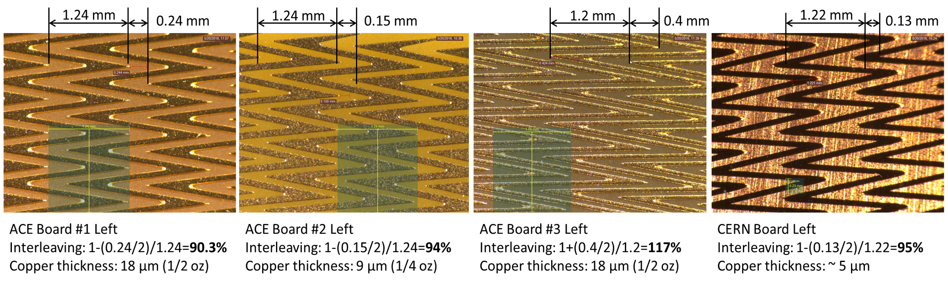
Improved Zigzag Strip Readout Design
Zigzag strips interleave almost all the way to centers of both neighboring strips:
Industrial
PCB
(10×10 cm²)
CERN
Foil
(10×10 cm²)
strip center
strip center
The design pushes the PCB manufacturing limit since spaces are below 3 mils (76 um)
Produced a foil readout board at CERN to verify that there is no problem with producing high-quality zigzag strips on a large-area kapton foil at CERN
Same design is implemented on large 1-m zigzag readout foil being produced at CERN

Slide 26
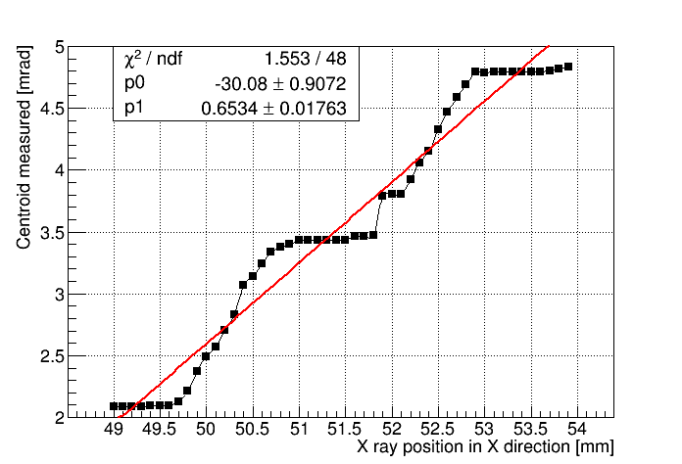
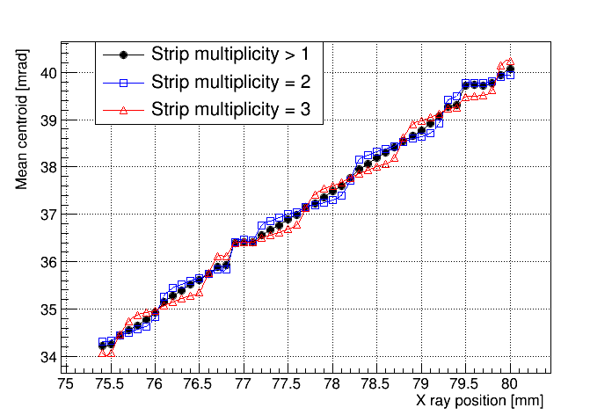
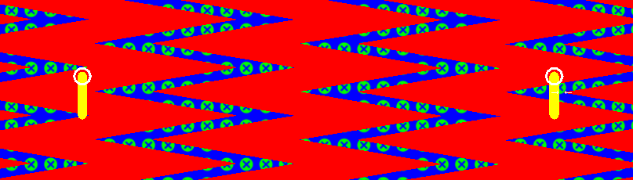
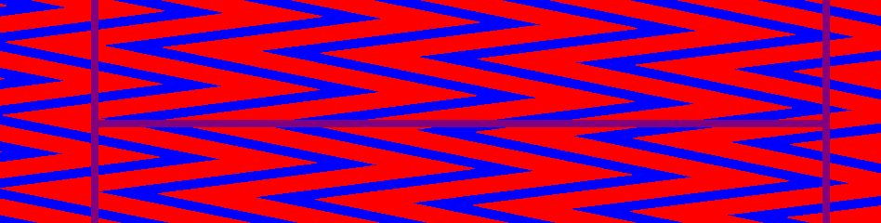
Much Improved Linearity
Mean centroid measurement vs. X ray position (scan across strips)
Previous zigzag design
New board (same angle pitch)
old design
new design
Flat regions insensitive to hit positions.
Linear response over whole range
> 95% events fire 2 or 3 strips.

Slide 27
Spatial Resolution
Measured resolutions for improved zigzag-strip readout boards:
Spatial resolution (µrad / μm) | V_{drift} (V) | Approx. gas gain | Strips with angle pitch 4.14 mrad, r ≈ 229 mm |  |  | Strips with angle pitch 1.37 mrad, r ≈ 784 mm
 |  |  | 2-strip clusters | 3-strip clusters | 2 & 3-strip clusters | 2-strip clusters | 3-strip clusters | 2 & 3-strip clusters
Industrial PCB | 3340 | 3000 | 288 / 66 | 480 / 110 | 384 / 88 | 57 / 45 | 97 / 76 | 84 / 66
CERN foil | 3340 | 3000 | 397 / 91 | 393 / 90 | 397 / 91 | - | - | -
CERN foil | 3380 | 4000 | - | - | - | 57 / 45 | 92 / 72 | 71 / 56
Previous PCB |  |  | - | - | - |  |  | 193 µrad
Linear resolutions (well) below 100 µm

Slide 28
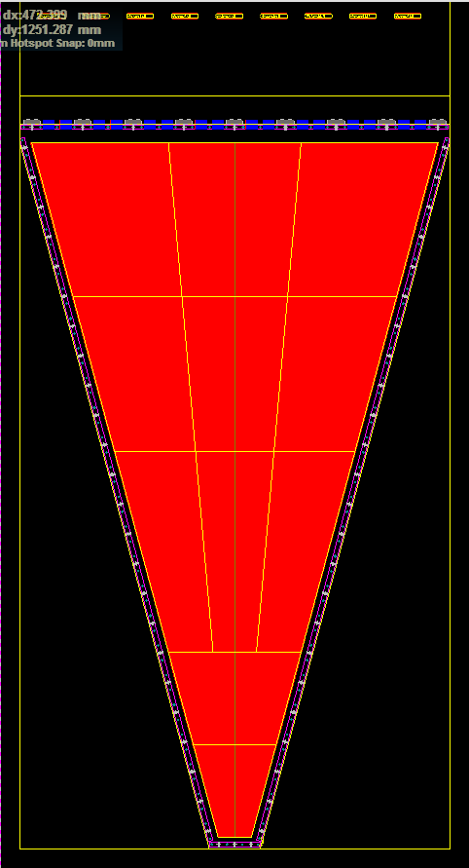
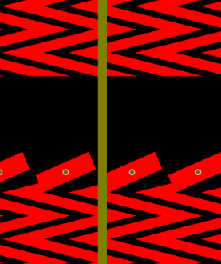
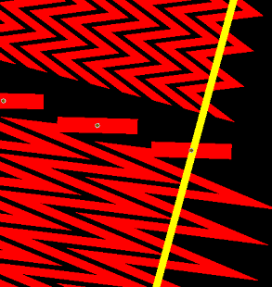
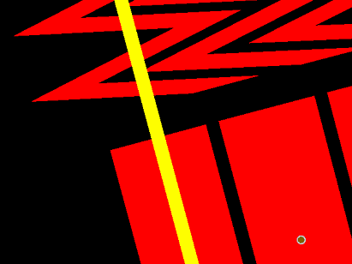
EIC Zigzag Readout Foil (FIT)
Sec. Nr. | Strip type | No. of strips | Angle pitch (mrad) | Sector Length (cm)
1 | Straight | 128 | 4.14 | 12
2 | Zigzag | 128 | 4.14 | 12
3 | Zigzag | 384 (3×128) | 1.37 | 22
4 | Zigzag | 384 | 1.37 | 22
5 | Zigzag | 384 | 1.37 | 22
Readout connectors (Panasonic 130-pin)
5
4
Adopt the improved zigzag strip design but use straight strips in small innermost sector 1
Divide readout into 5 main eta sections
Produce r/o on a foil material (<200 µm thickness) so that total material in detector is reduced
Total number of channels is 1152 (=128*9)
Only 9 APV chips to read out the full detector
Foil is a 2-layer design; signal routing from strips to connectors for APV front end was a challenge
Foil currently in production at CERN
Expect delivery by end of March 2017
Sector 3
Sector 2
Sector 1
30.1º
opening angle

Slide 29
Summary & Outlook
Large-area GEM detectors have become quite popular with a diverse set of experiments
Active EIC forward GEM tracking R&D since 2011
    Conceptual design for full EIC FT disk
    Built a common 30.1º GEM foil
    Developing & testing different assembly methods and readout designs
    Second round of full-size prototyping in progress
    Planning tests with X-rays and possibly beam in 2017
EIC Forward Tracking R&D readily applicable to RHIC detectors for forward spin physics

Slide 30
Thank you!

Slide 31
Backup

Slide 32
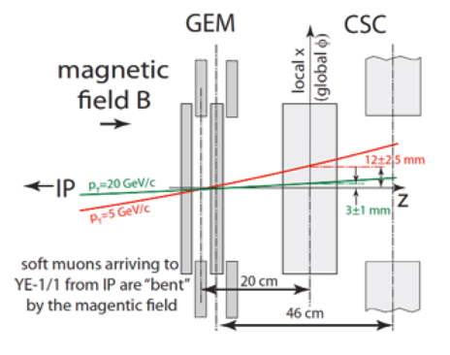
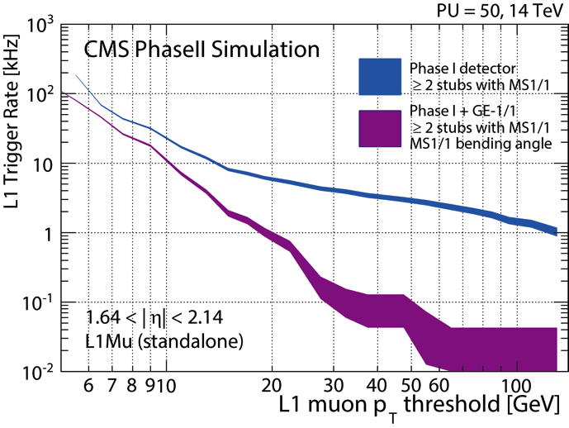
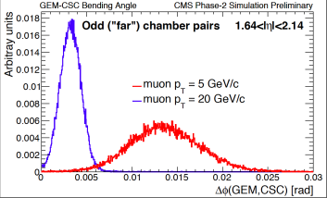
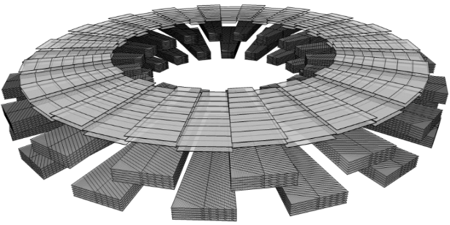
GE1/1: Muon Measurement
GE1/1 creates a large lever arm with the CSC ME1/1 chambers
  Enables precise measurement of muon direction
  Much improved Level-1 trigger momentum resolution and lower rates in otherwise a problematic region of the detector
Lever arm - trigger
X3 reduction
Maintain low p_{T} online threshold, keep < 5 kHz rate, high efficiency
32

Slide 33
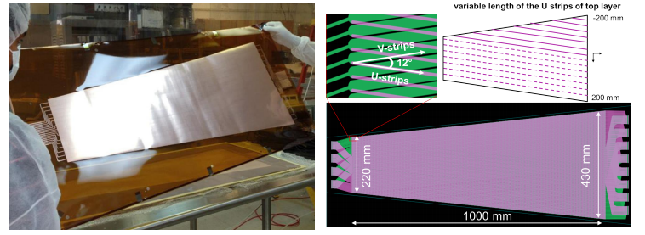
First Iteration
The U. Va group has assembled and tested a 1-m long triple-GEM detector equipped with 2D stereo angle (U-V) strips.
Assembly method: glue foils to frames that are held together to with screws.
Resolutions of 60 urad in azimuthal direction and better than 550 um in radial direction are achieved.
Ref.: NIM A 808 (2016) 83

Slide 34
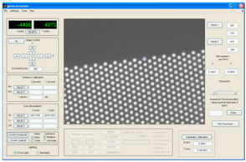
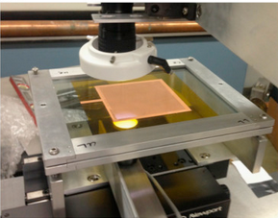
GEM foil scanning (Temple)
Scanned 40 cm × 40 cm GEM foils from commercial supplier and small CERN foils with an automated CCD camera setup. Currently upgrading CCD scanner so that large GEM foils can also be scanned.
NIM A 617 (2010) 196-198
NIM A 802 (2015) 10-15
Example: Inner hole diameter distributions

Slide 35
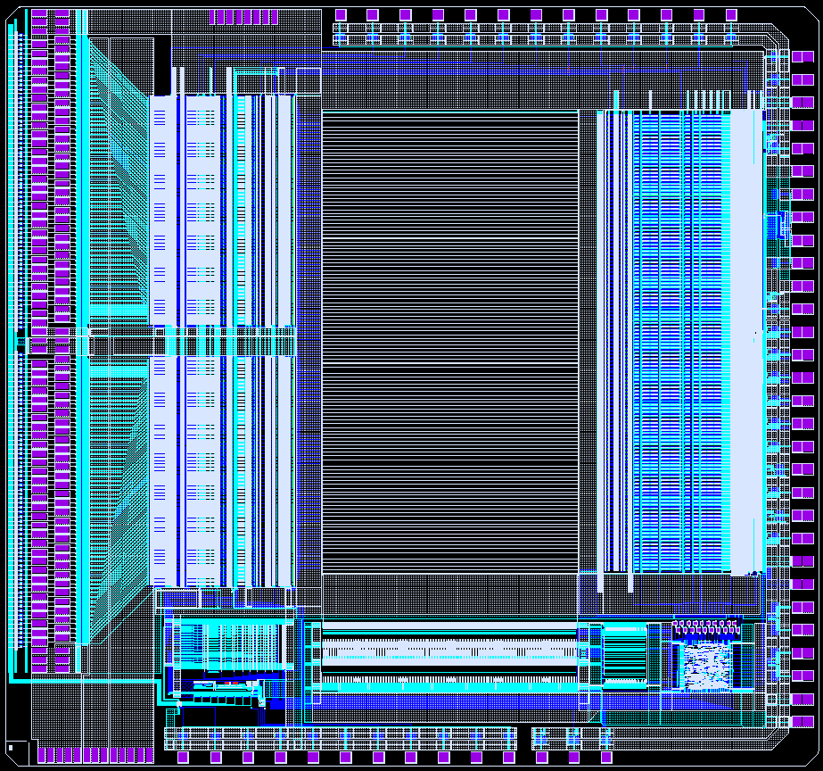
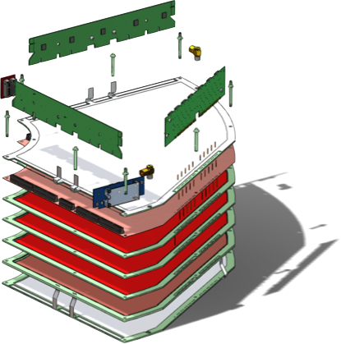
STAR FGT Quarter Section
Readout module
APV chip
Pressure volume
Terminator board
HV board
2D readout board
GEM layers (1-3)
Interconnect board
Pressure volume
HV layer
Pressure volume

Slide 36
Readout design at FIT group zigzag strips
-> Type A has been tested in our previous prototype (arXiv:1508.07046), type B will be chosen for the next prototype. The reason is: type B design gives better charge sharing and shows less non-linear response.
Simple model simulation results (courtesy of Alexander Kiselev, BNL)

Slide 37
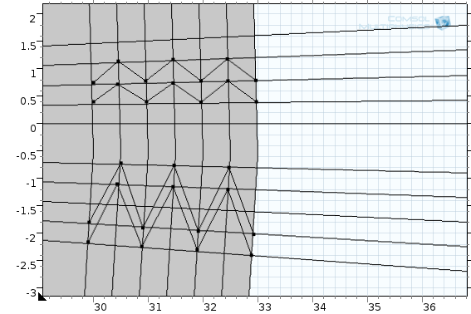
Readout design at FIT group zigzag strips
Strip center
Neighbor strip centers
Reference lines
Type A
Type B
Figure by A. Ataei
R step
Start R
Angle pitch: α
F*α, 0<F<1
-> Four parameters to construct a zigzag strip: α, F, startR, stepR.
-> Two types of zigzag structure can be made: (1) type A, a zigzag strip not exceeding the two reference lines; (2) type B, a zigzag strip covers centers of the two neighbor strips.

Slide 38
Centers of strips
Reference lines
Y (arbitrary unit)
X (arbitrary unit)

Slide 39
Y (arbitrary unit)
X (arbitrary unit)

Slide 40
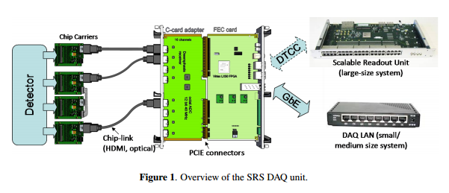
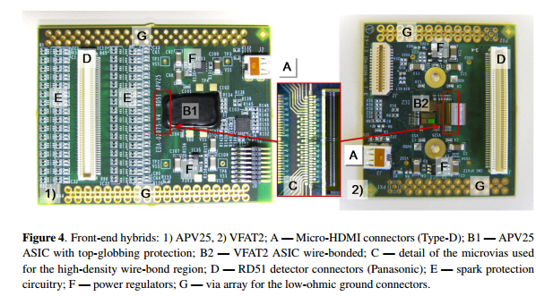
Electronics – SRS and APVs
Ref.: 2013 JINST 8 C03015

Slide 41


Signal routing from readout strips to connectors
Connectors for APV chips
Signal lines are blue (top side)
Zigzag strips are red (bottom side)
Connection made with vias
0.5 mm

Slide 42






Optimization of the zigzag strip readout design – X ray scan results
FIT
Resolution studies with CERN board for strips with angle pitch 1.37 mrad, radius ≈ 784 mm
Cluster strip multiplicity = 2
Residual dist.
Residuals
Centroid
Cluster Strip multiplicity = 3

Slide 43




Optimization of the zigzag strip readout design – Results of X-ray scans at BNL
FIT
Mean centroid vs. X-ray position
Strip angle pitch 4.14 mrad, radius in EIC ≈ 229 mm
Strip angle pitch 1.37 mrad, radius in EIC ≈ 784 mm
Best board from PCB comp.
CERN
kapton foil
board
-> The response is much more linear than with the original zigzag design!
-> There are a few flat regions due to backlash of the motor when data taking was interrupted.

Slide 44




Readout design at U. Va group
2D stereo angel strips (U-V strips)
Angles between U-V strip is 12 deg.
20 APVs (2560 channels) to read out a detector.
K. Gnanvo, U.Va

Slide 45





2D (U-V strips) readout with zebra connection concept
2D U-V strips readout board
Test on a small 10x10 triple GEM prototype
Contact of U and V strips on either side of the R/O foil
Small GEM prototype with zebra
Zebra’s side (to R/O U-V strip)
Top strip
Zebra to Panasonic adapter PCB
Kapton
Bottom strip
Zebra holder on the adapter
Zebra contacts
Panasonic side (to FE card)

Slide 46




Preliminary results on small 2D (U-V strips) triple GEM prototype with Zebra connection
Distribution of pedestal rms (noises) over 512 APV25 chs
Pedestal noise level comparable to standard COMPASS 2D readout
No effect of the zebra connection on noise level
COMPASS readout
standard connection
U-V strips readout
zebra connection
Cluster size > 3.5 ⇨ improvement in spatial resolution
Occupancy for U and V strips: Linear dependence with strip length is shown
bad zebra contact
X-ray
Uniformity of the gain uniformity: (accumulated ADC / numbers of hits)

